Slide 1
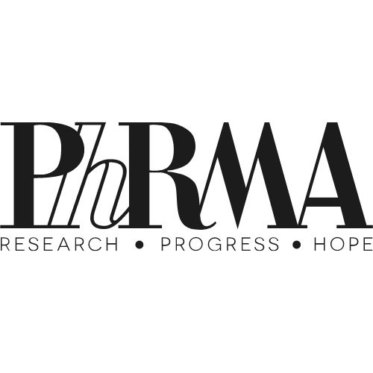


Behind the 340B Drug Pricing Program
A
X
PARTNERSHIP

Slide 2

The big picture
Prescription medications are more expensive than they should be, and programs like 340B which were initially meant to support low-income and uninsured patients — are actually lining the pockets of private pharmacies and hospitals.
Why it matters
Axios’ Smart Brevity Studio and PhRMA’s partnership yielded a one-of-a-kind multi-platform experience telling the story of why patients are in need of a better drug pricing policy, and to spark conversations on necessary improvements to the 340B program.

Slide 3
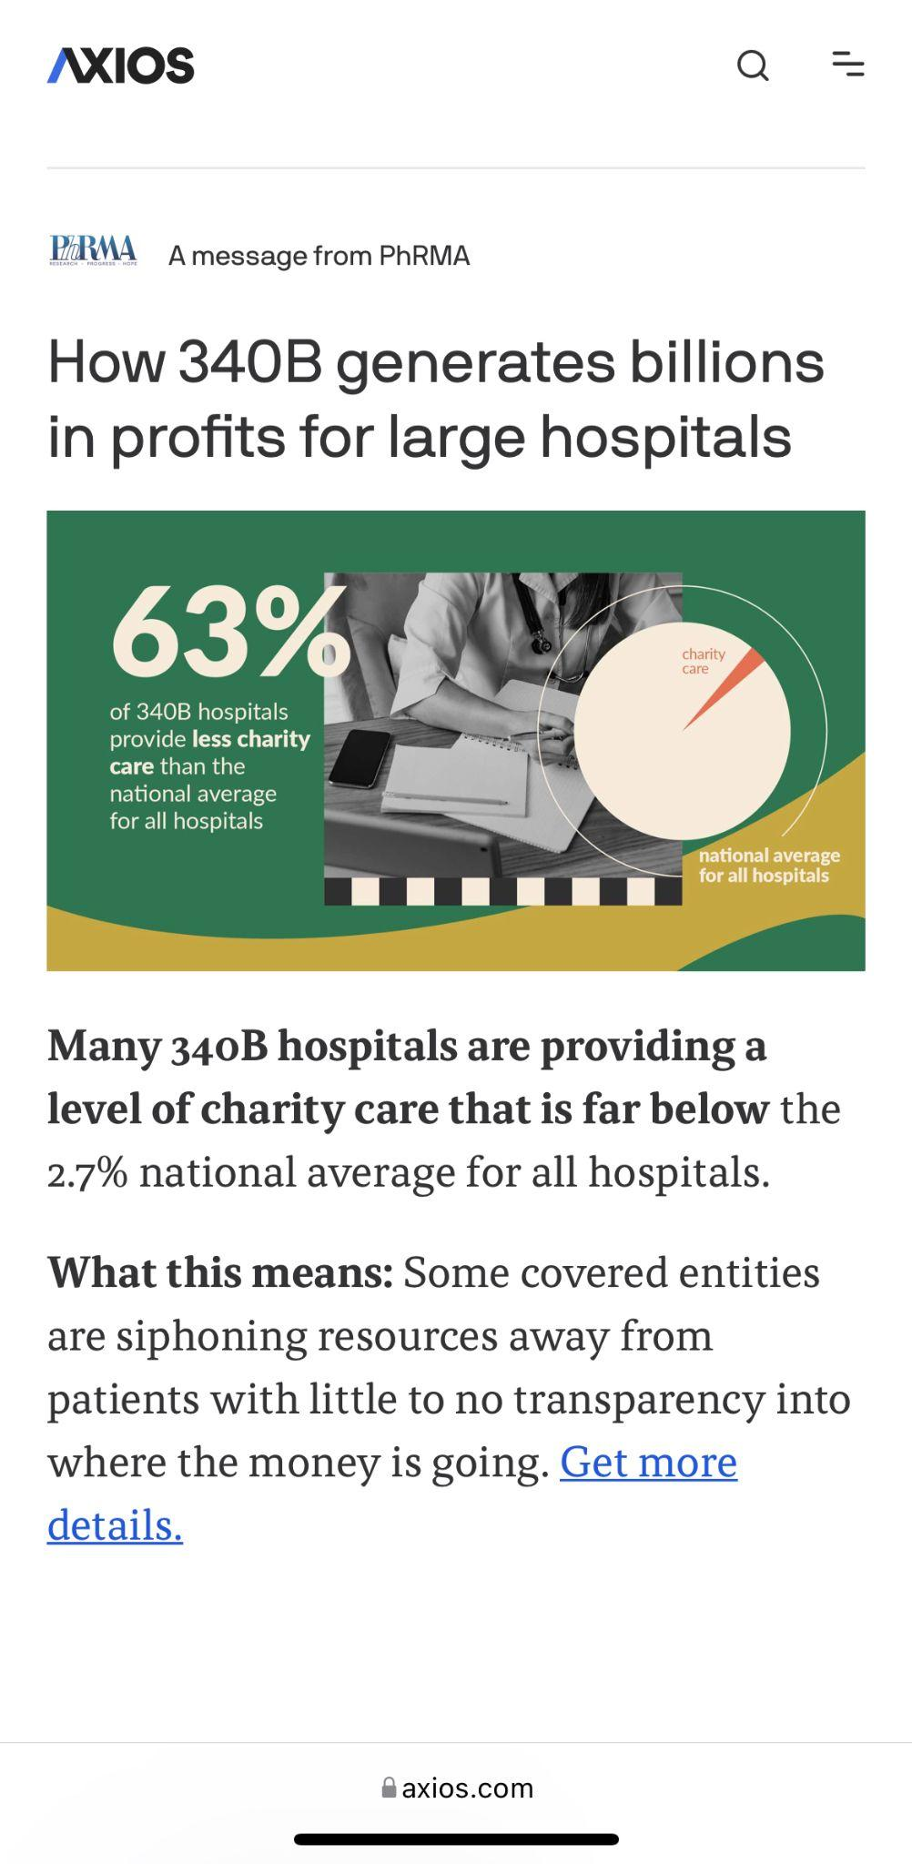
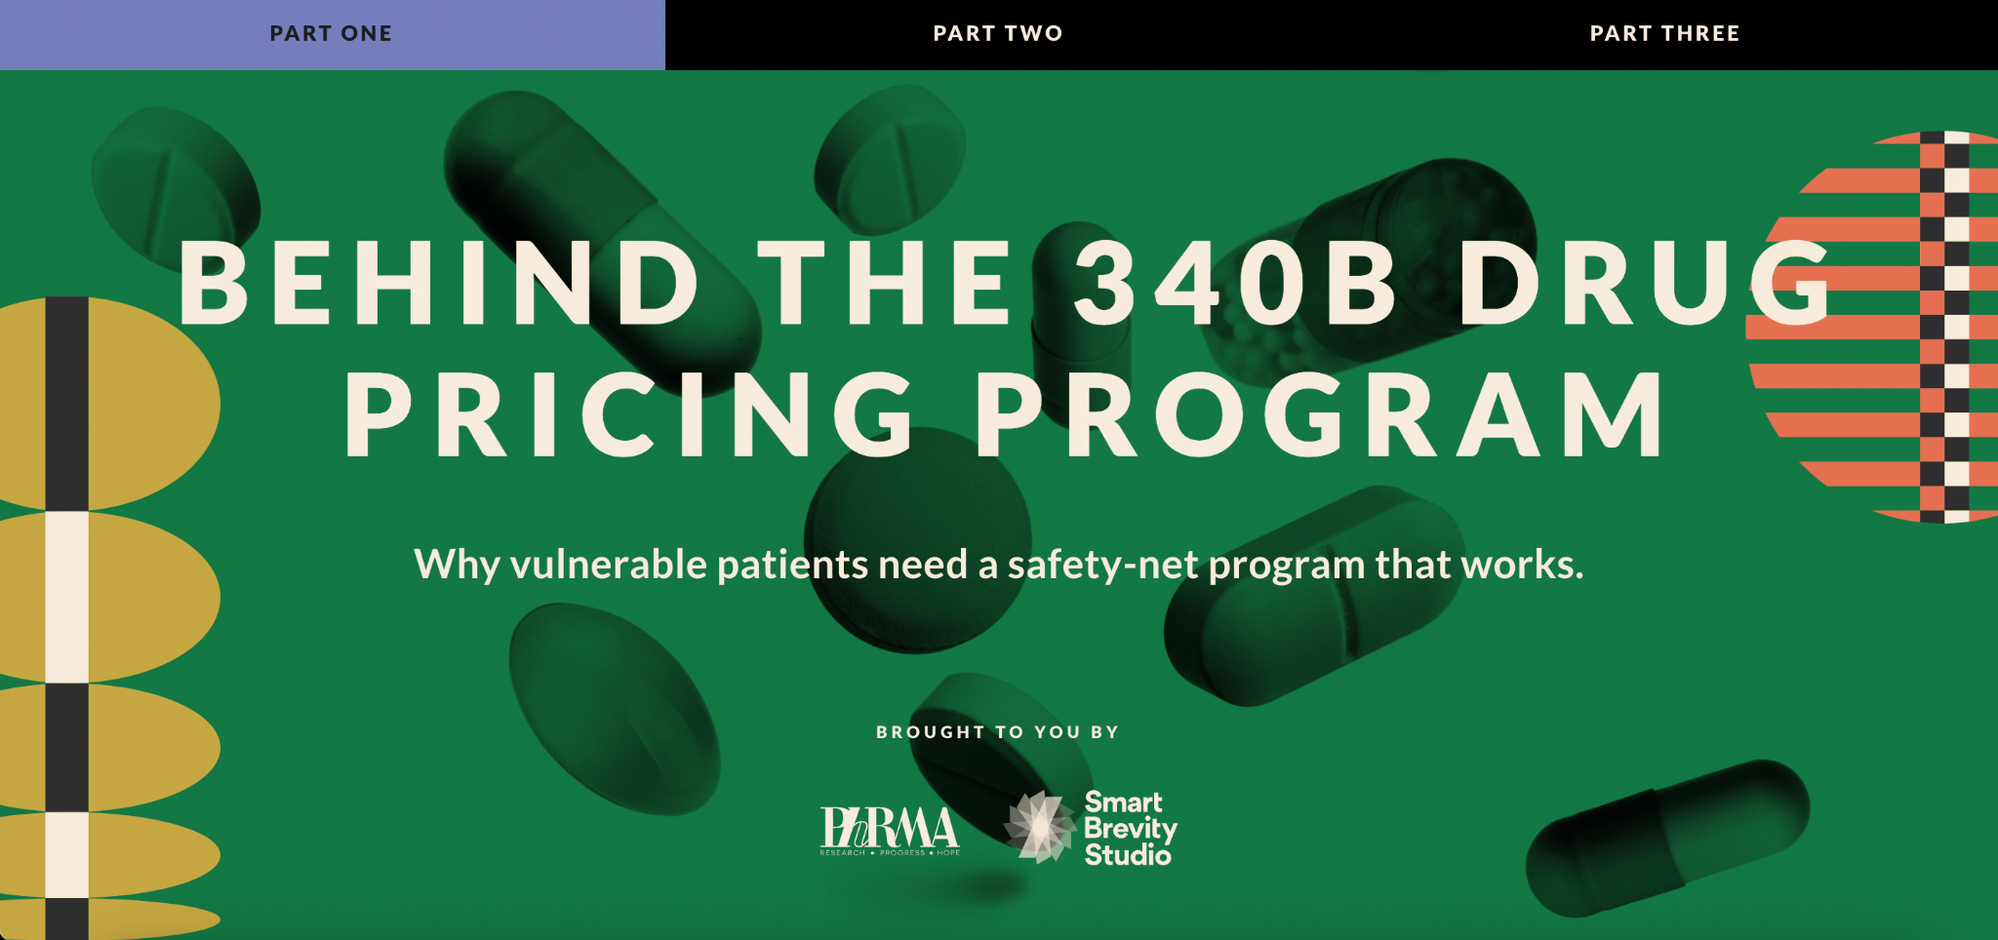

Campaign at a glance
1. Collections Page + 3 Stories
3. Native Visual Posts on Axios.com
2. Custom Explainer Video

Slide 4
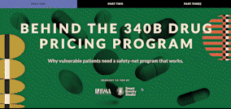
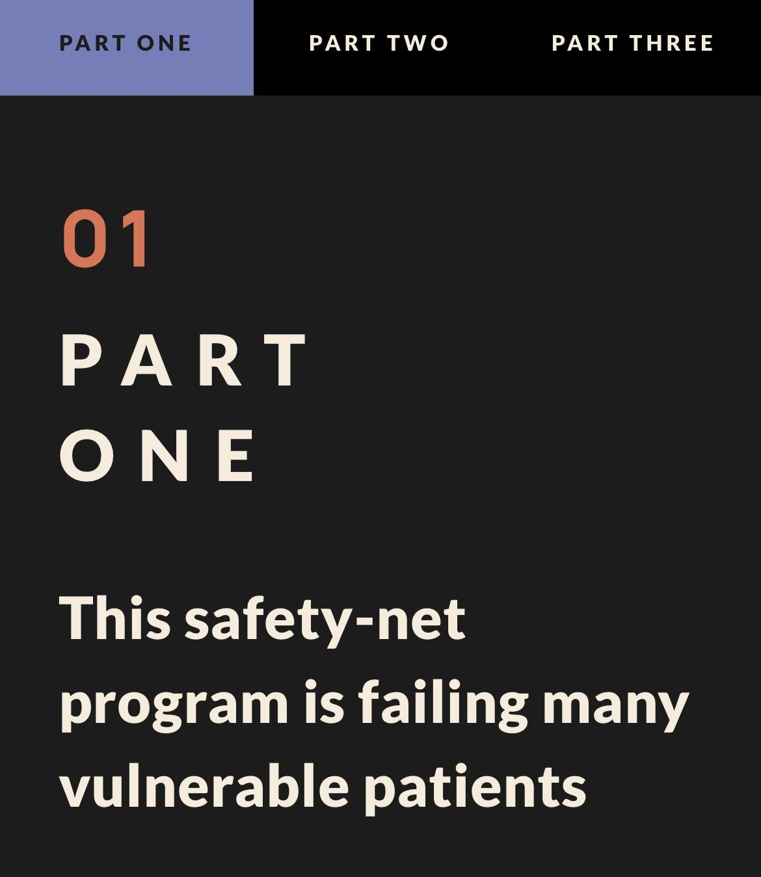
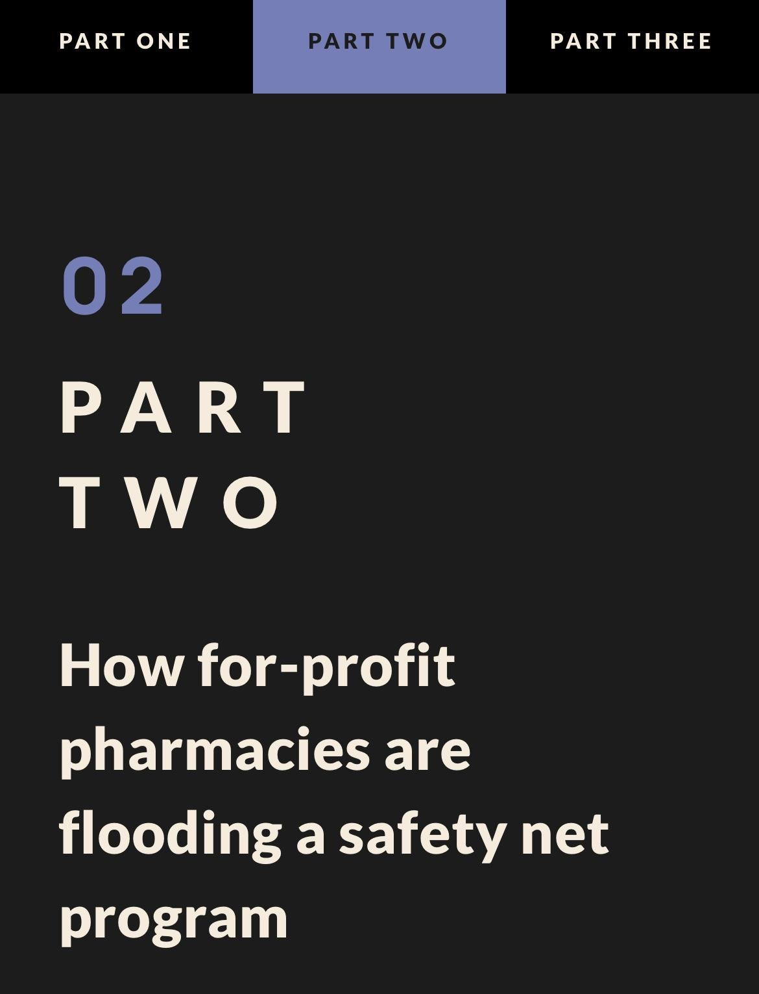
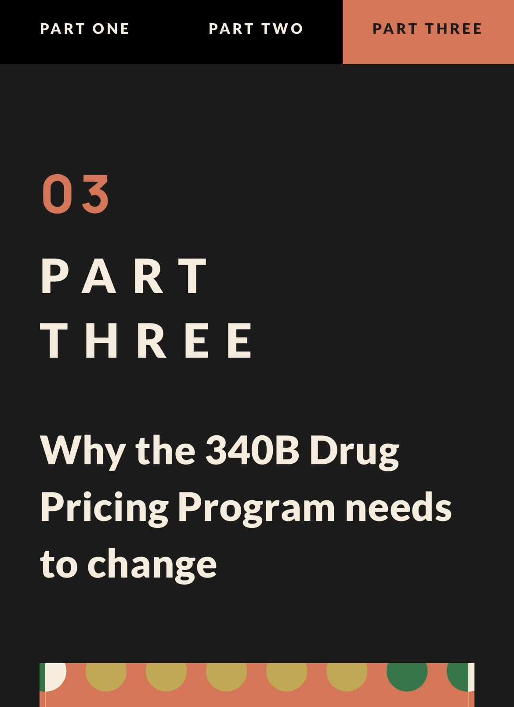
Total pageviews: 10,976
Unique visitors: 10,112
Average time across pages: 4.1X over industry benchmark
Collections Page + Stories
Collections Page
Time spent: 2:37
Story 1
Time spent: 3:52
Story 2
Time spent: 4:02
Story 3
Time spent: 2:50
Industry average time spent on page: 49 seconds
Notes:
Story images are hyperlinked

Slide 5
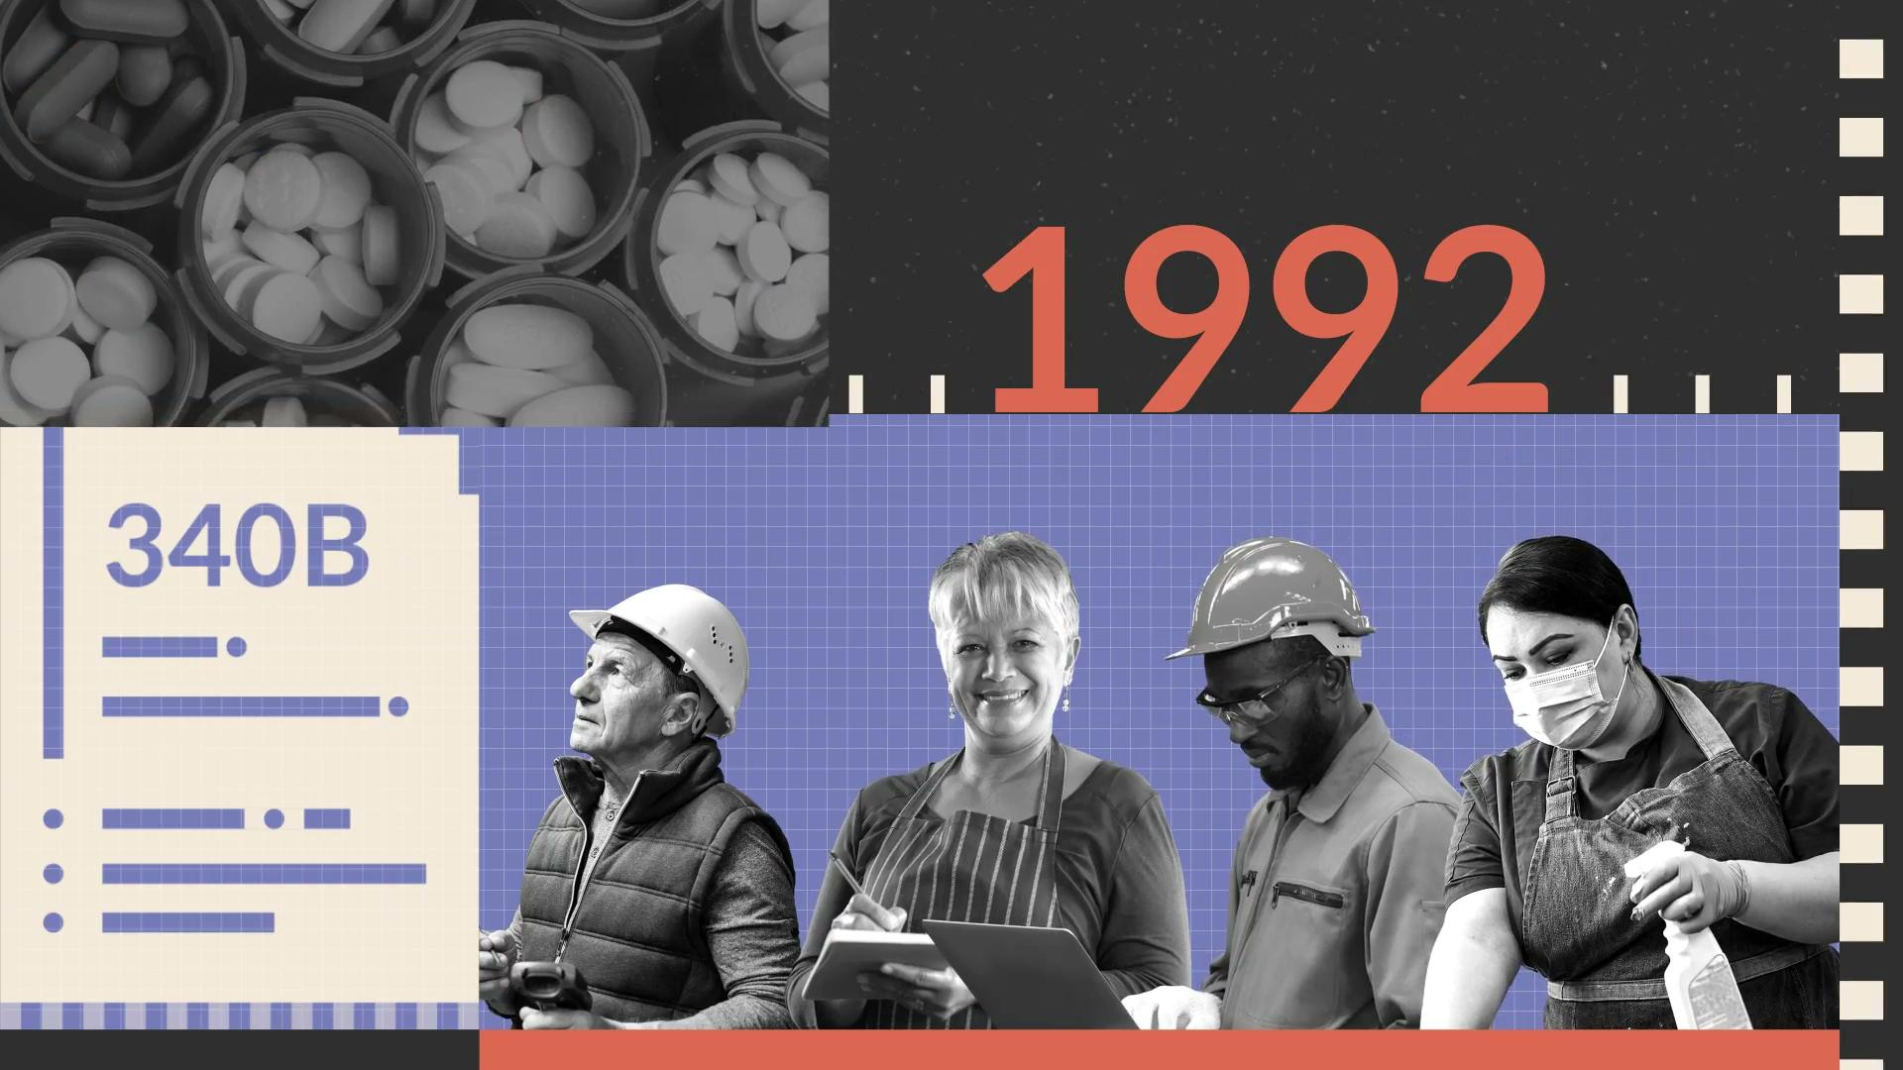
Explainer Video
206K
Video Views
1.4X
Average CTR over Axios benchmark
1K+
Clicks
Industry benchmark CTR: 0.08%
Axios benchmark CTR: 0.10%

Slide 6
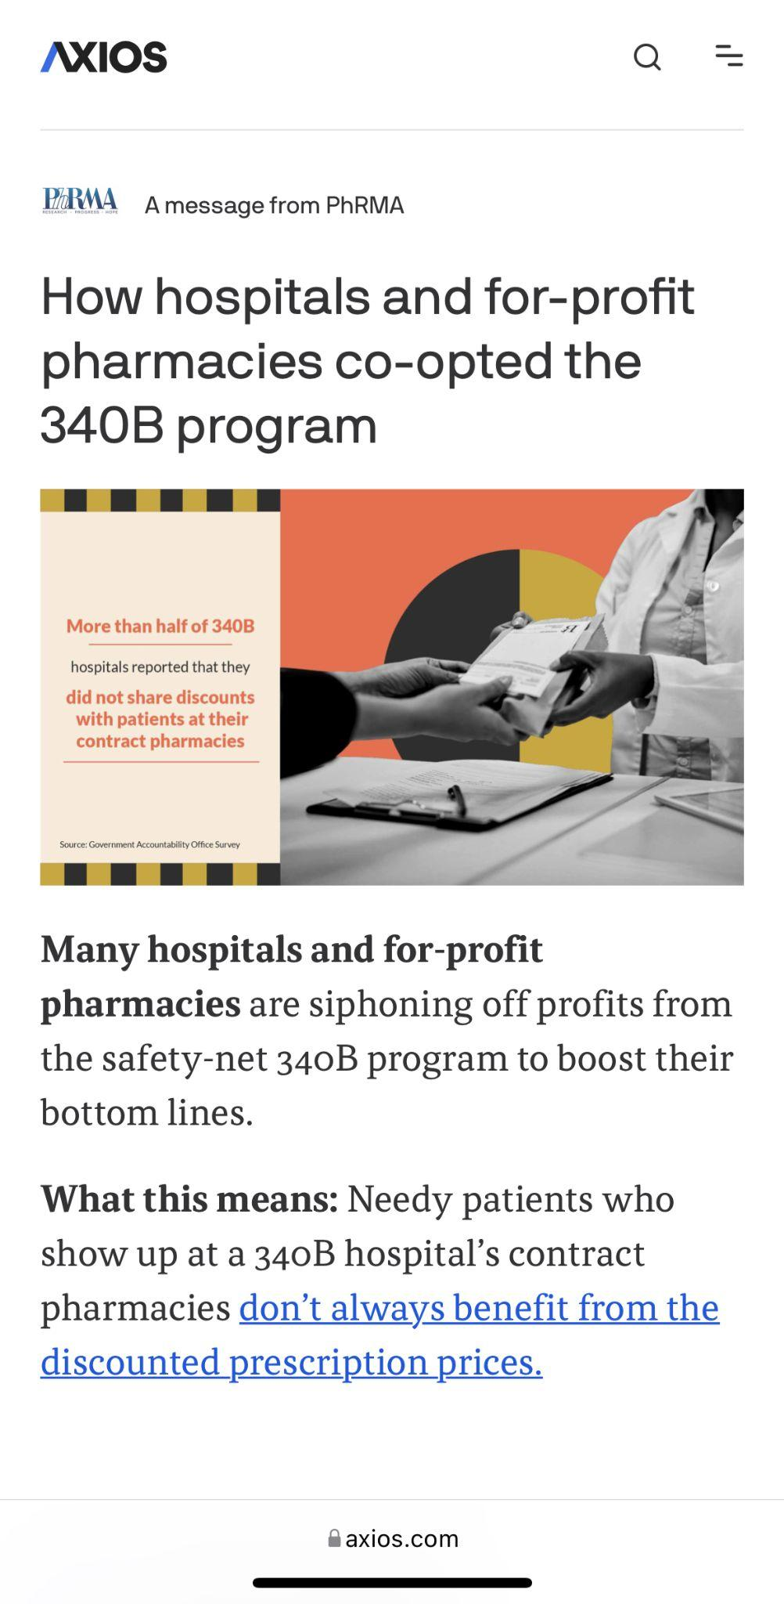
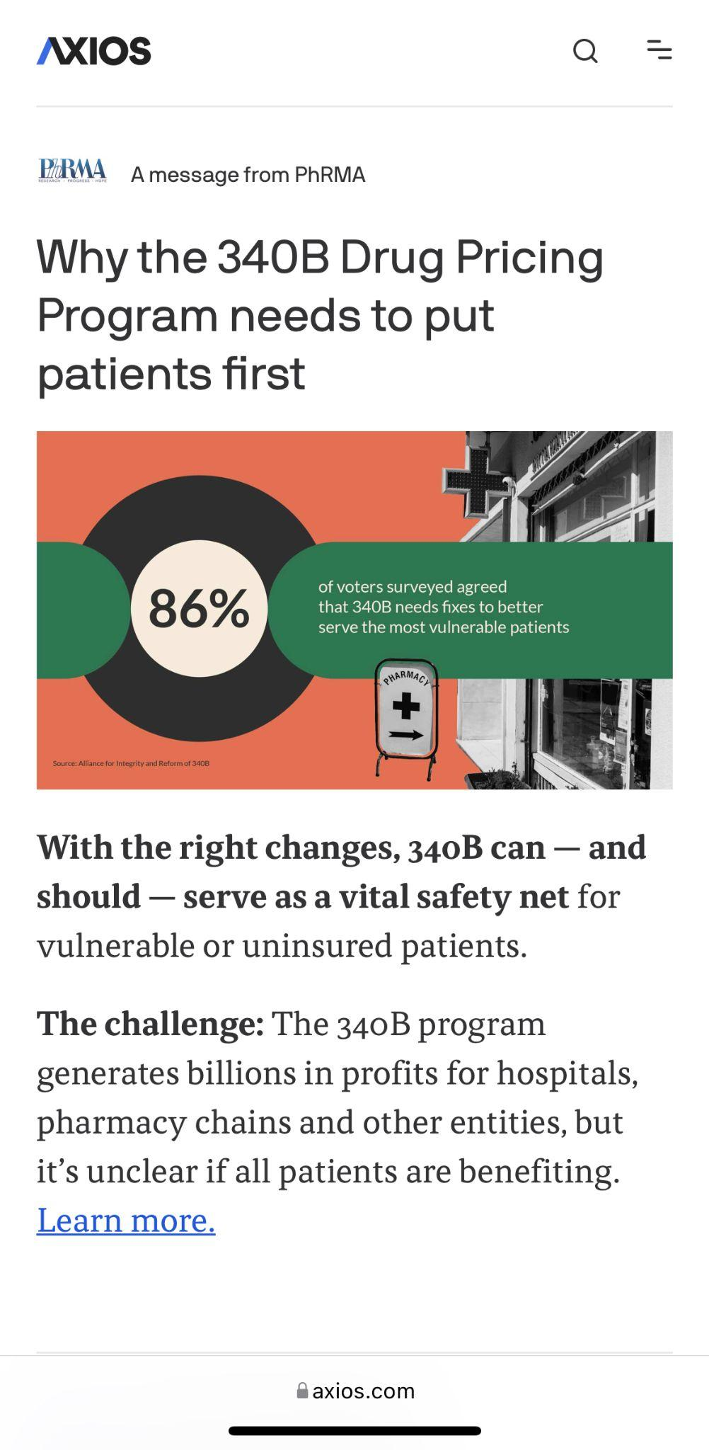
Visual Posts
CTR: 0.40%
CTR: 0.27%
CTR: 0.24%
Average CTR: 0.28%
3.5X
Over Industry benchmark
2.8X
Over Axios benchmark
Industry benchmark CTR: 0.08%
Axios benchmark CTR: 0.10%

Slide 7
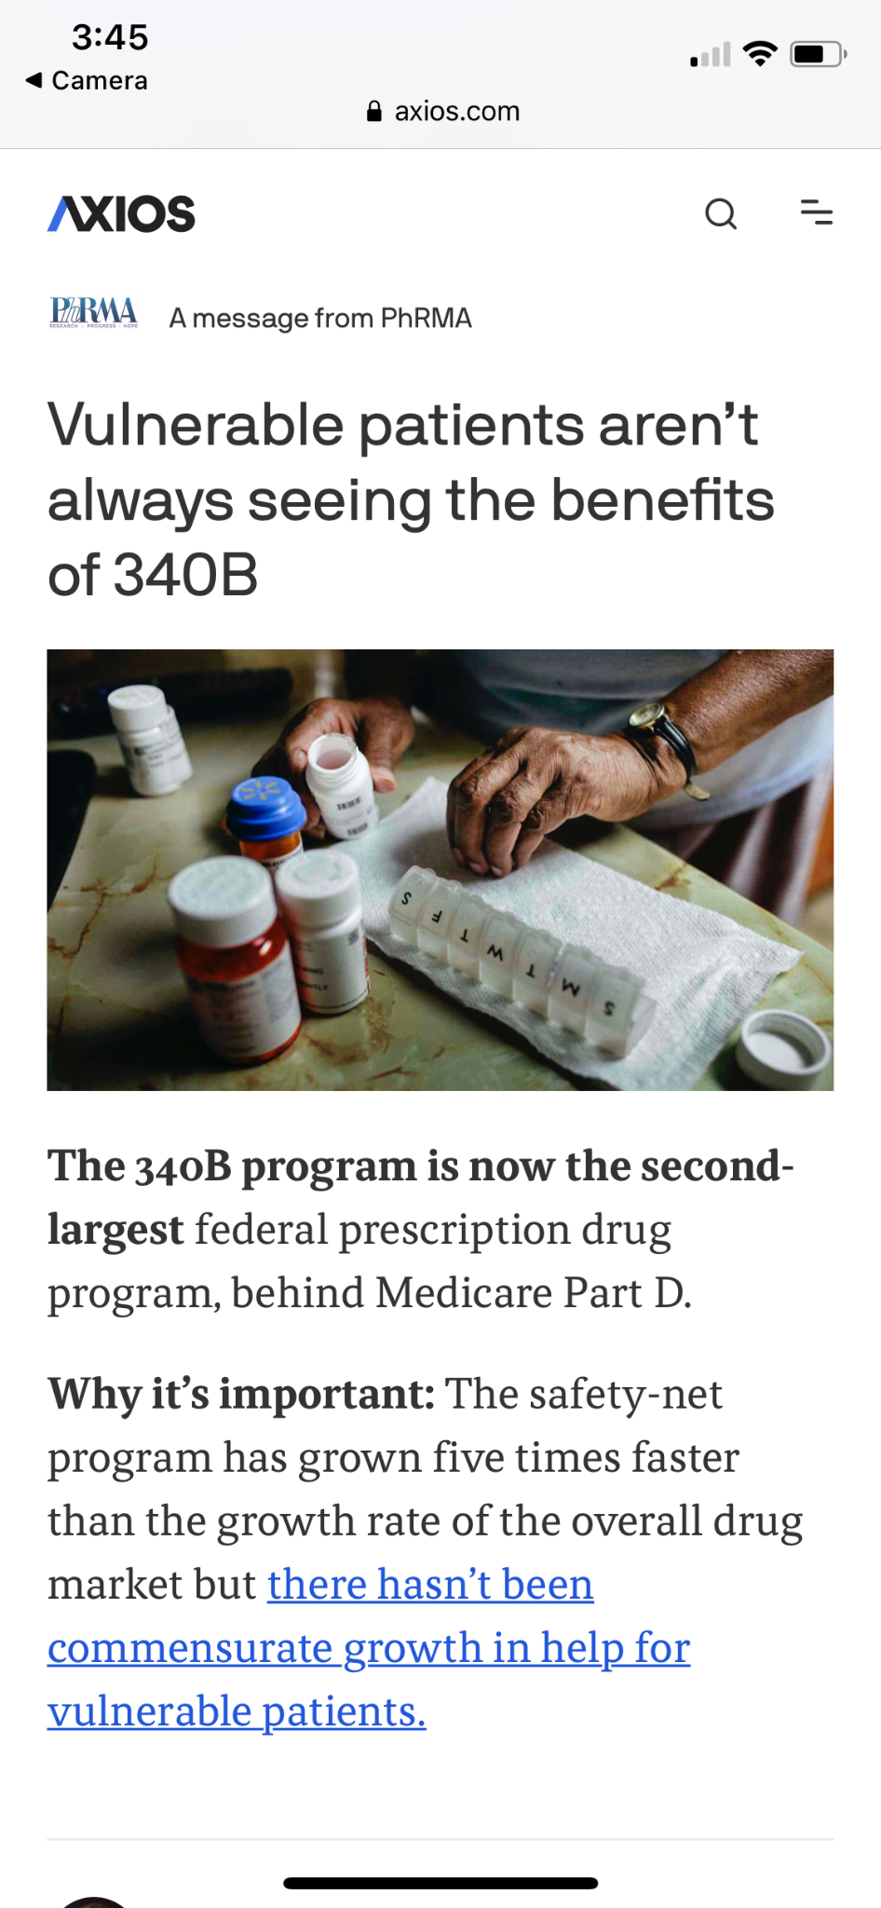
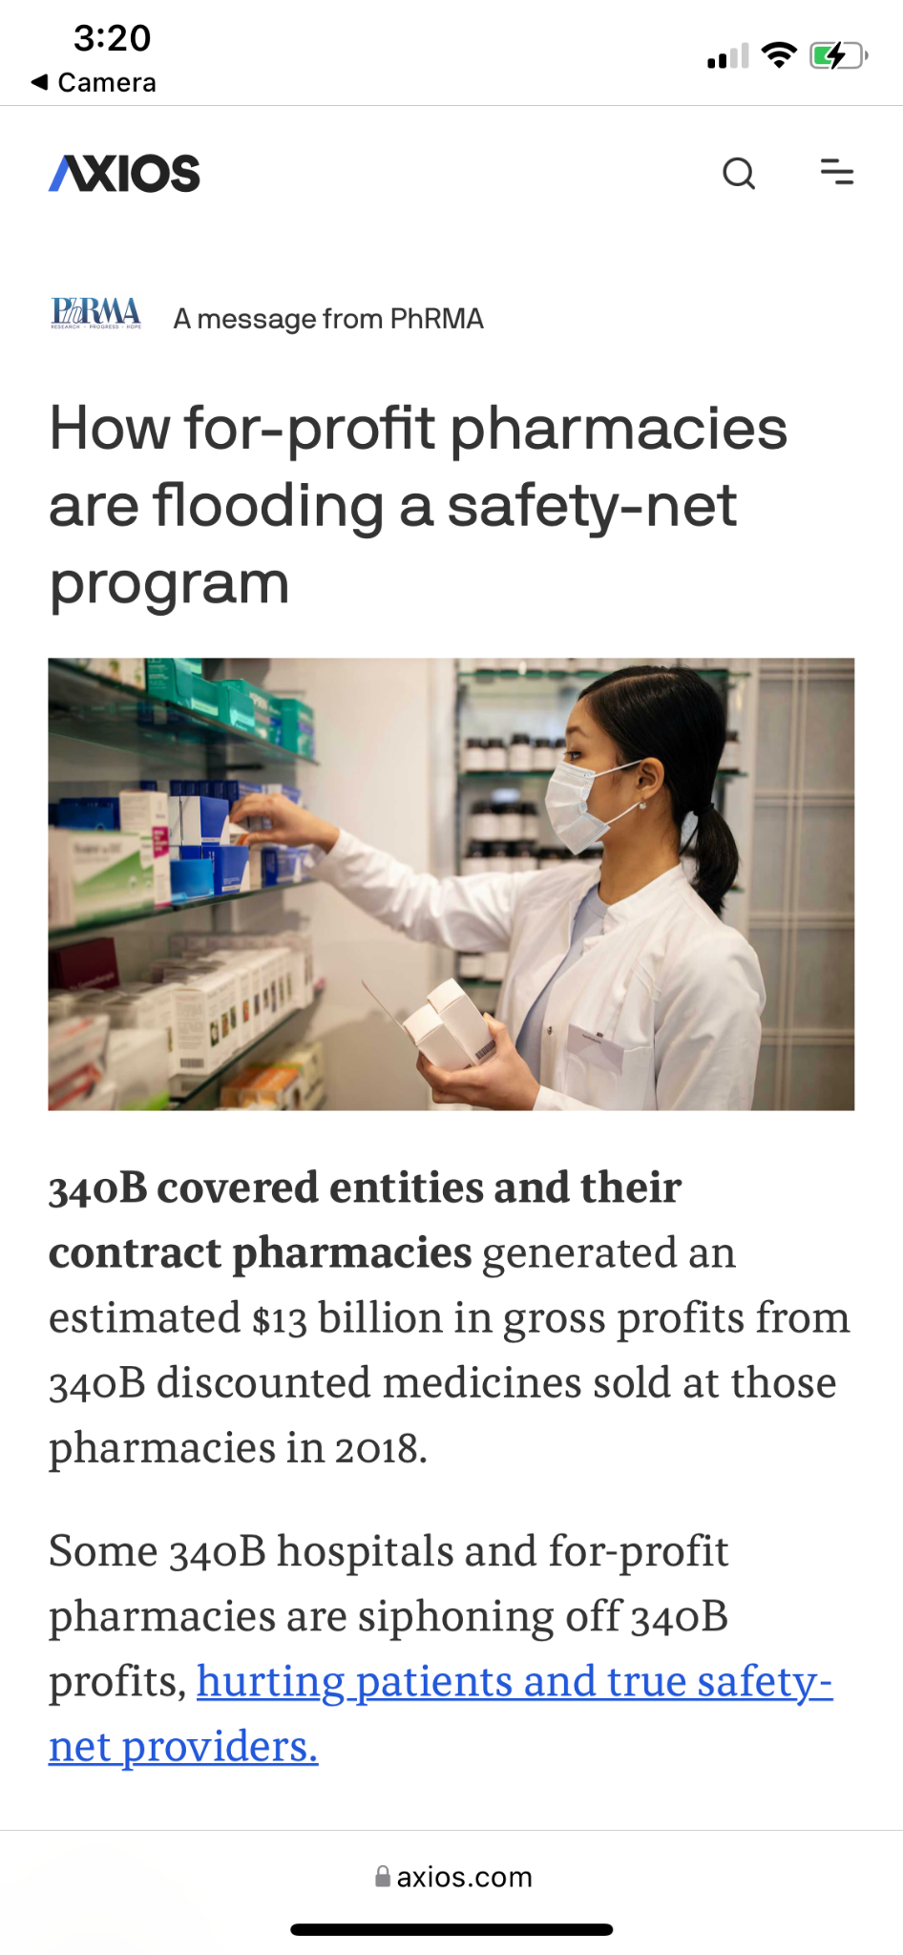
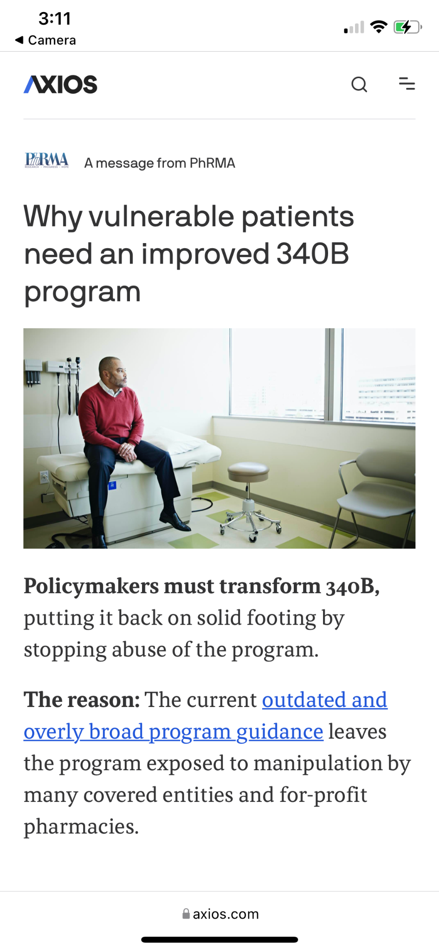
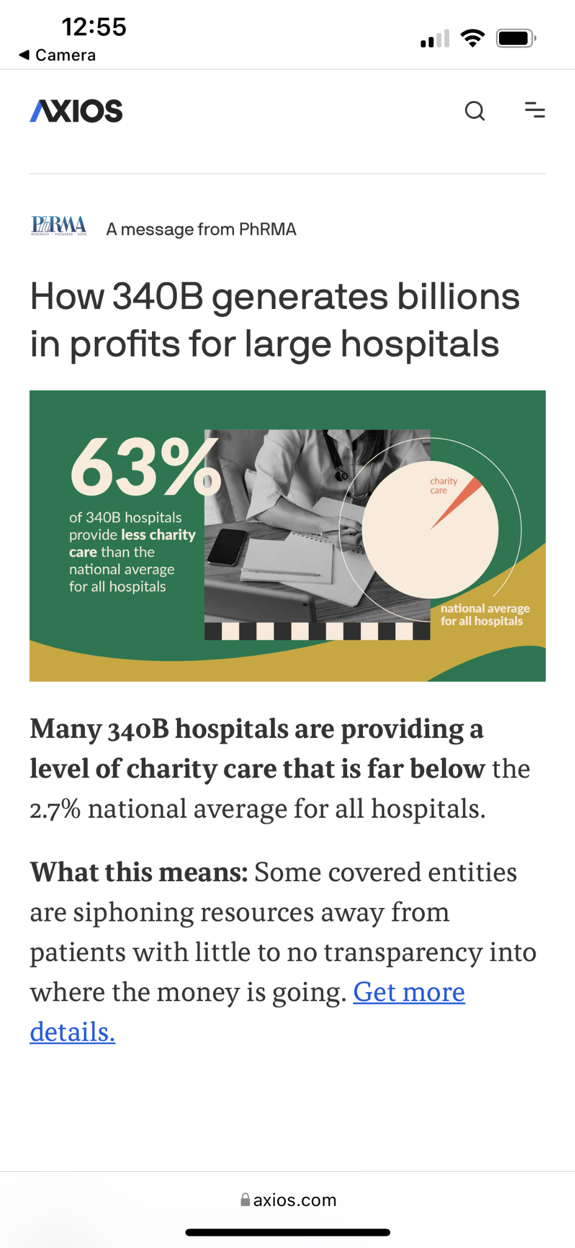
Promotional Highlights
Story 1 top performer, 0.33% CTR
Story 2 top performer, 0.23% CTR
Story 3 top performer, 0.18% CTR
Collections Page top performer, 0.30% CTR

