Slide 1




The State of the U.S. Energy Industry
Q2 2021 Campaign Wrap Report

Slide 2
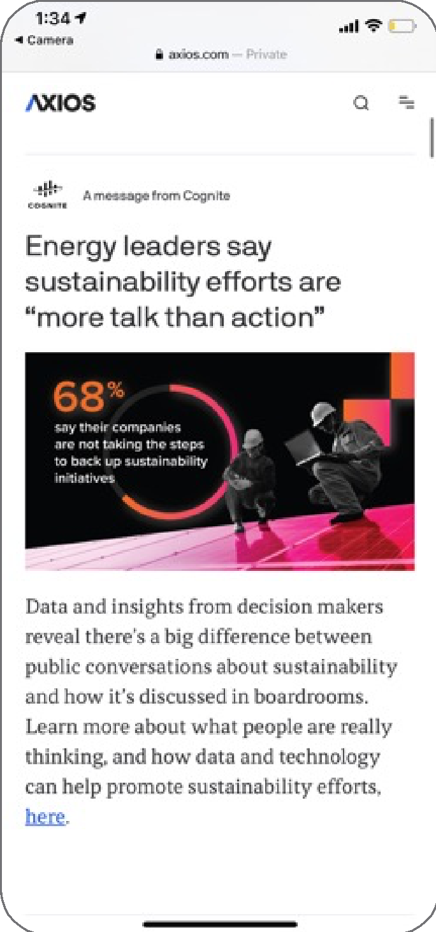
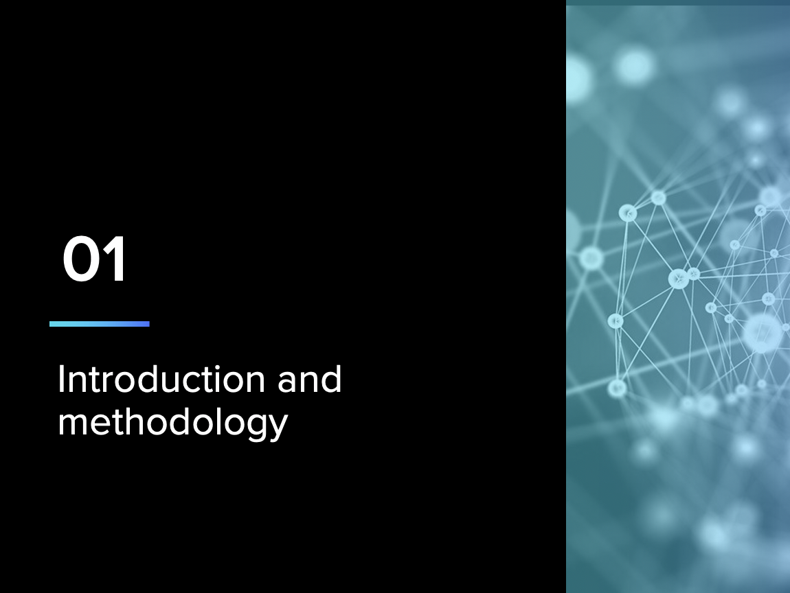

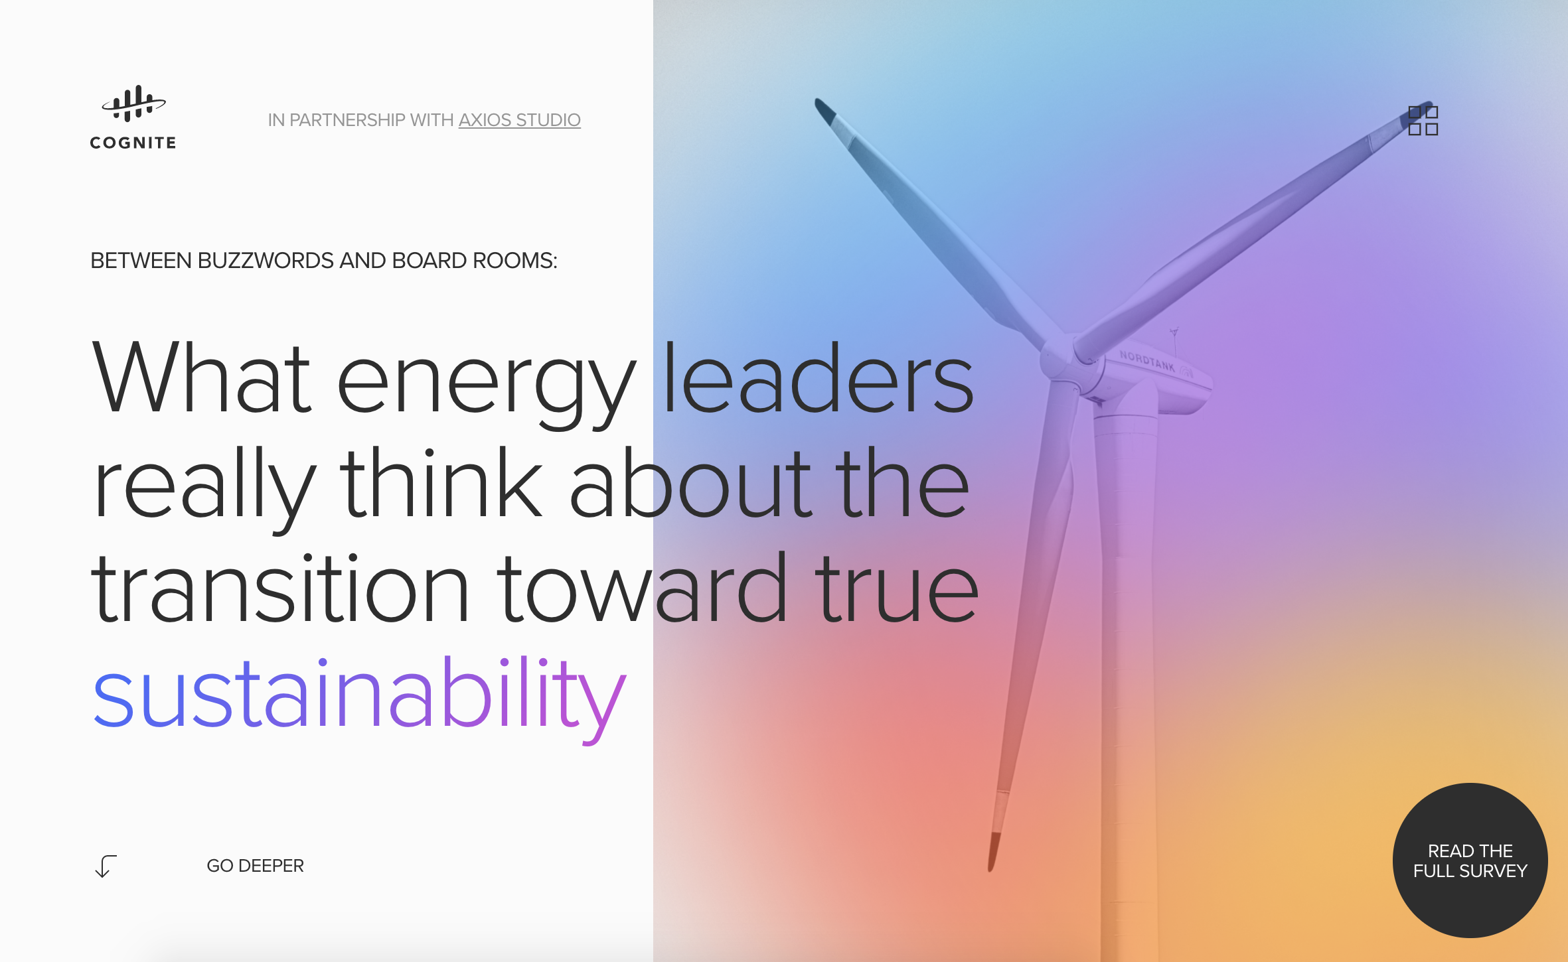
Campaign at a glance
1. Custom Report conducted by Axios and Harris Poll
3. Branded Topic Page
2. Custom, native Visual Posts on Axios.com

Slide 3
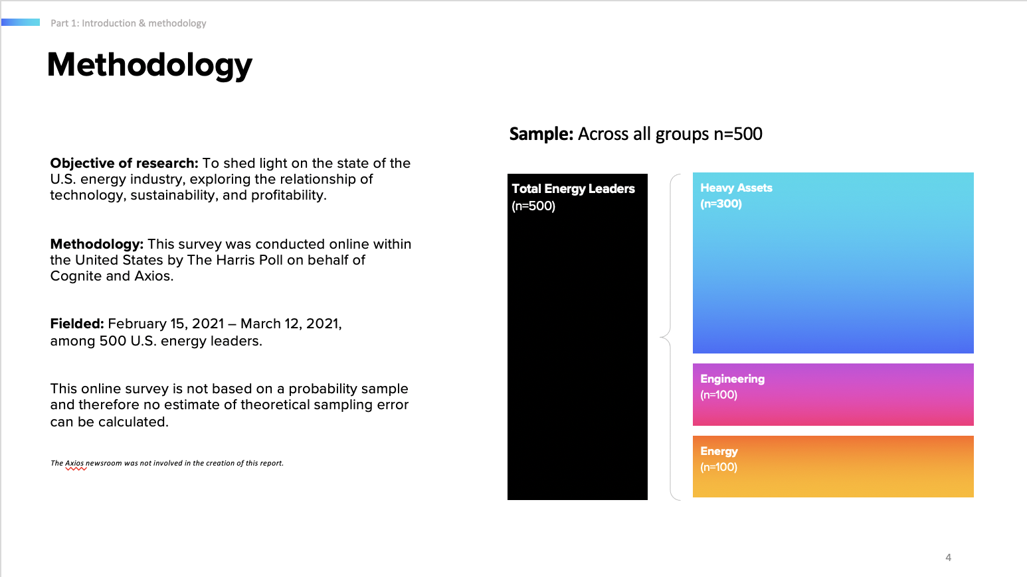
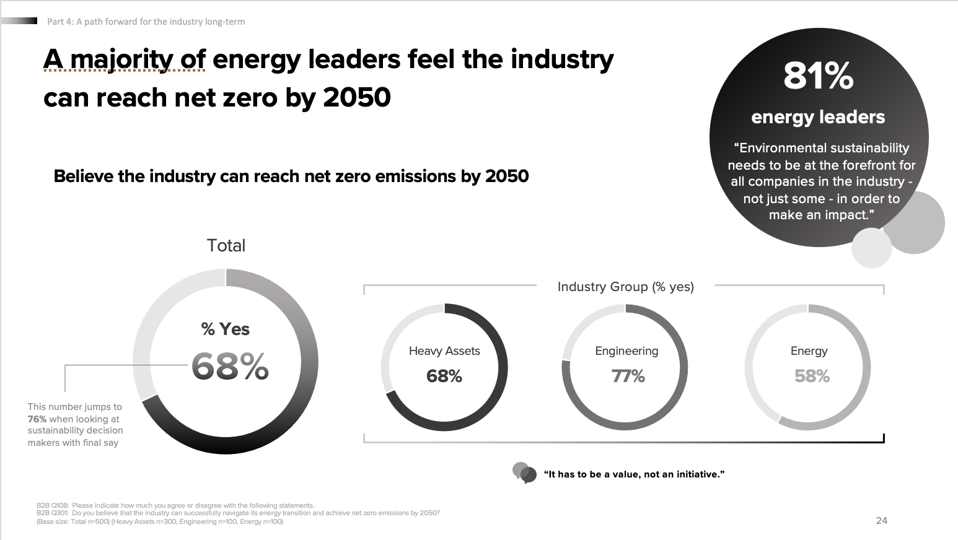
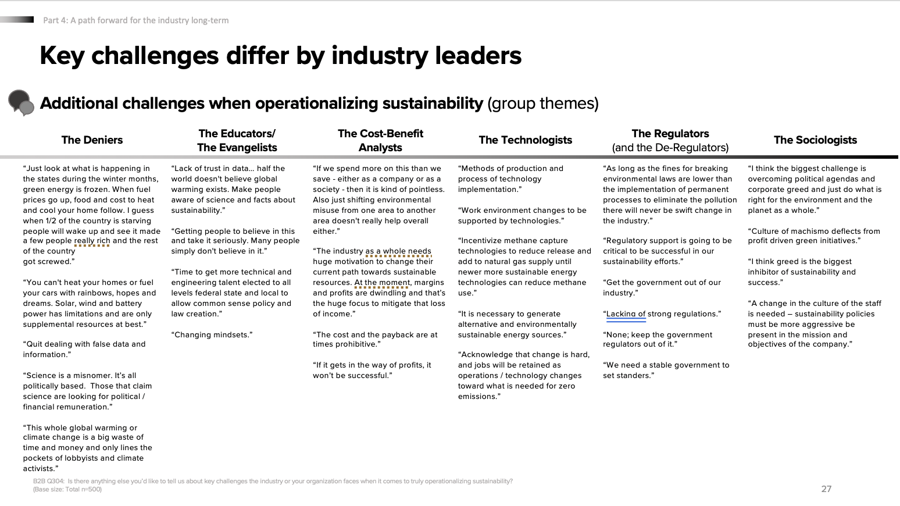
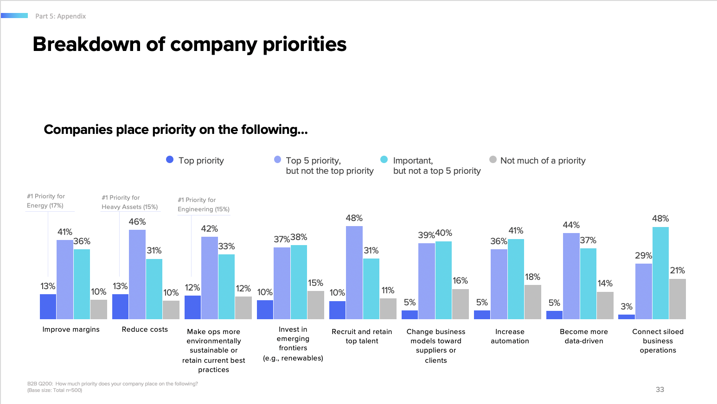
1. Custom Report
In partnership with Harris Poll, Axios and Cognite designed a survey used to amplify Cognite’s messaging by using the data findings to write and design strategic content.
Key takeaways
Corporate politics are preventing the industry from advancing sustainability
Energy leaders are calling for increased transparency to drive meaningful change
Technology is the “#1 most important next step for driving sustainability”
Technology is also critical for operational optimization
Understandings about the drive to net zero differ among leaders

Slide 4
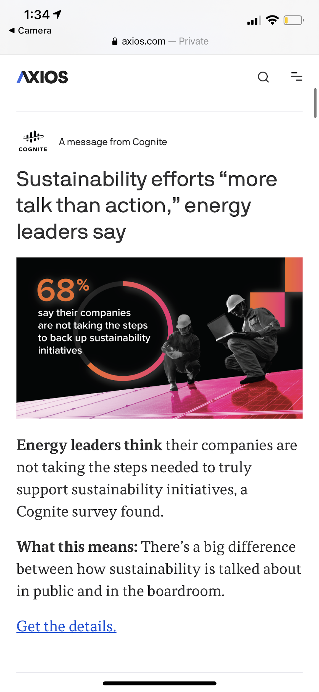
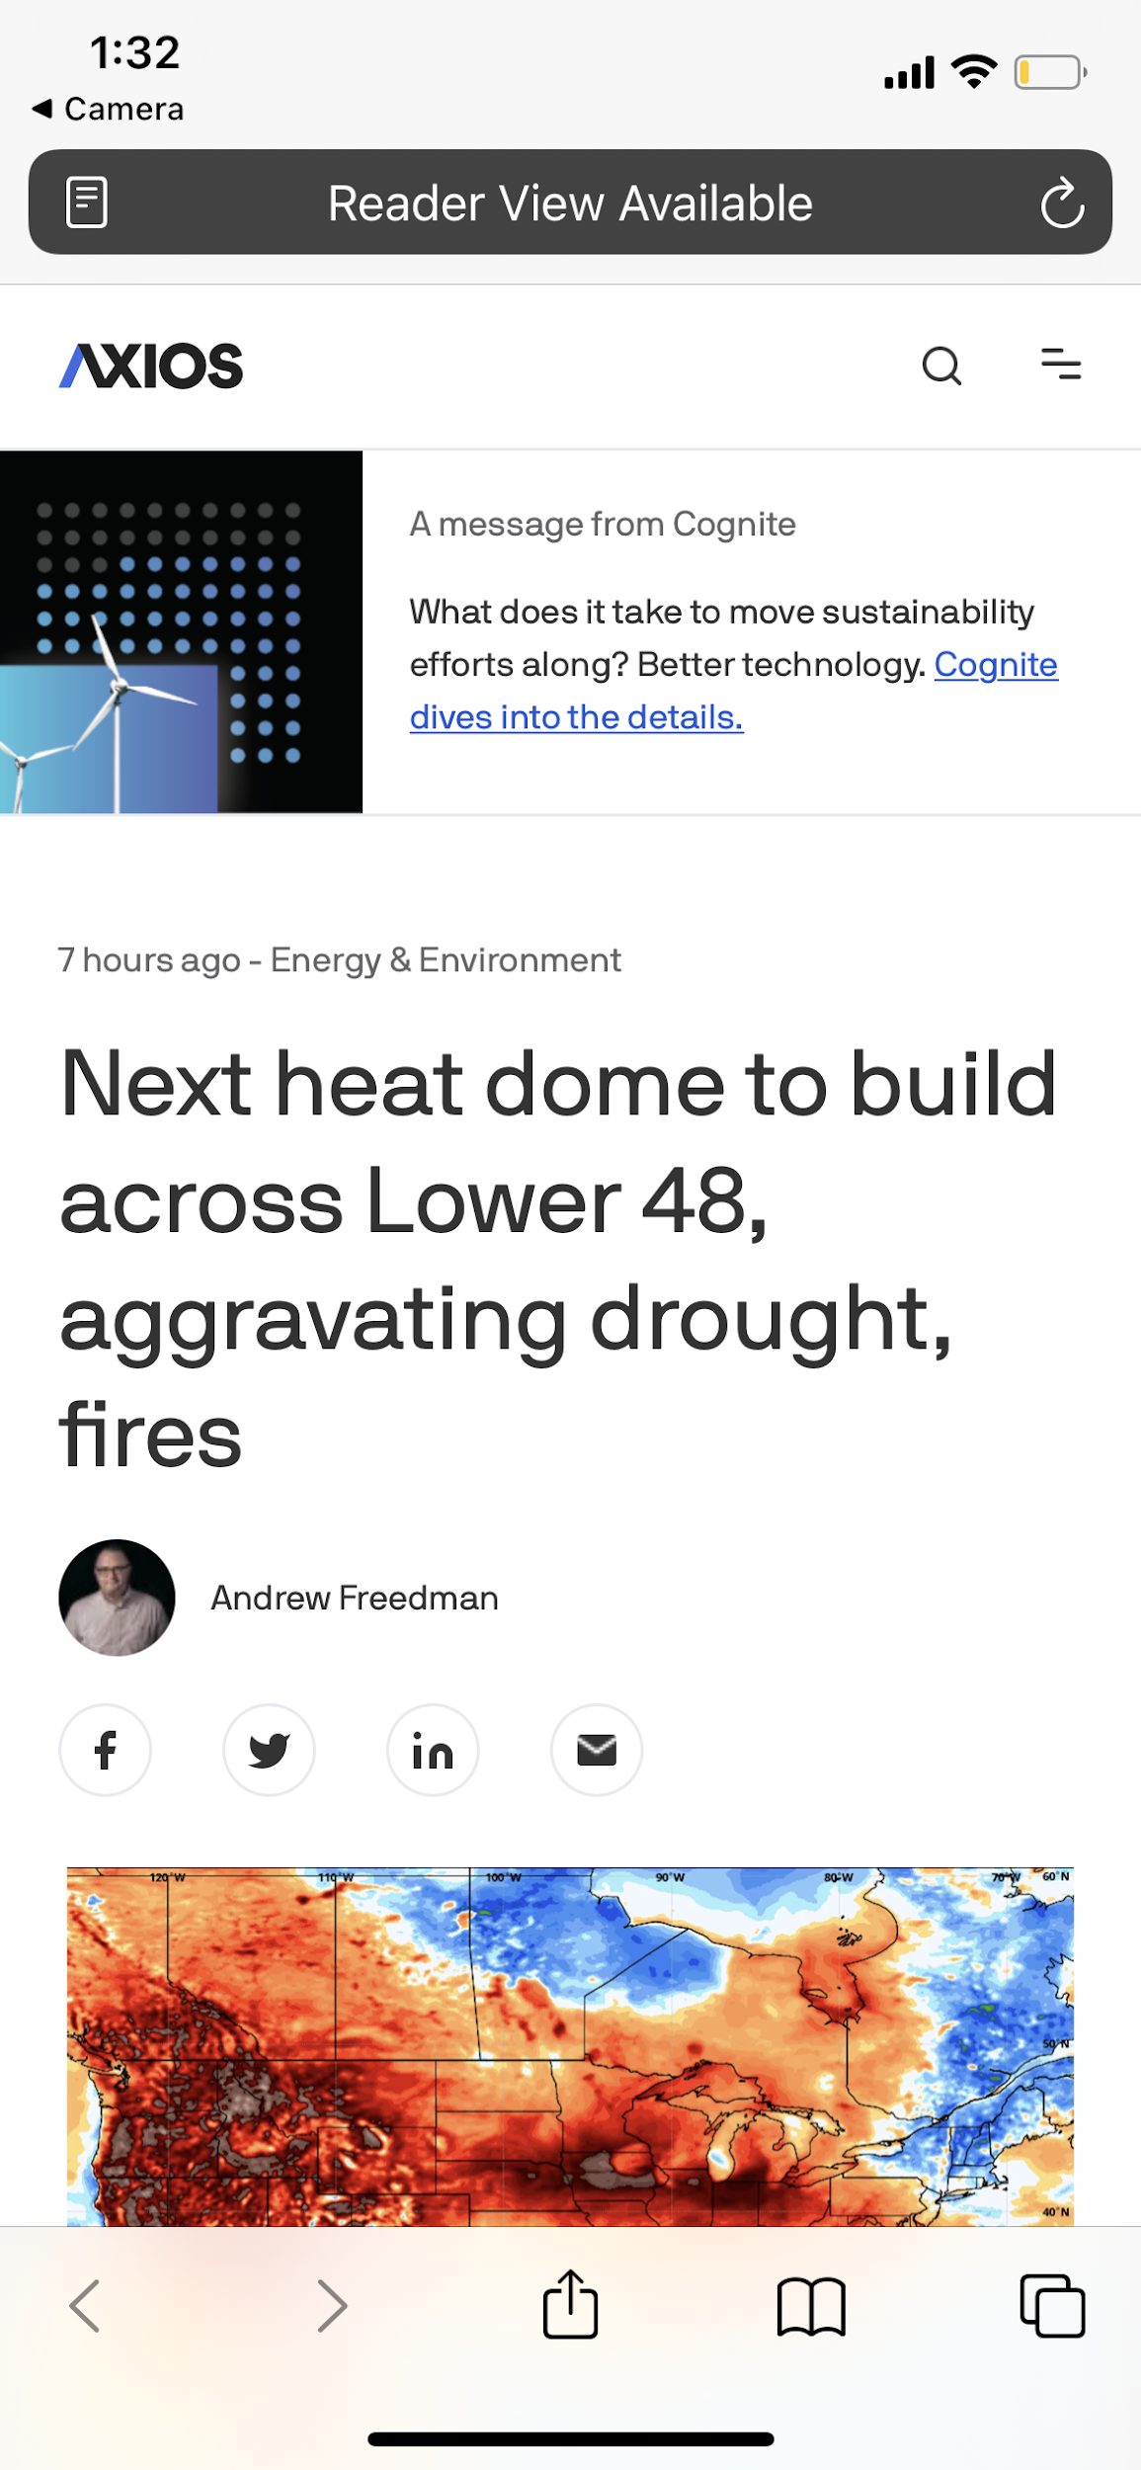
2. Visual Posts
Top Performing Smart Post
Top Performing Apex
.11% CTR
.14% CTR
Native Smart Post and Apex units on Axios.com, in addition to Facebook placements, promoted the report to readers by driving them to the branded landing page and report sign-up form.
Key takeaways
6.9MM
Impressions (Axios and Facebook)
12.9K
Clicks
.19%
Avg. CTR
.14%
CTR benchmark

Slide 5
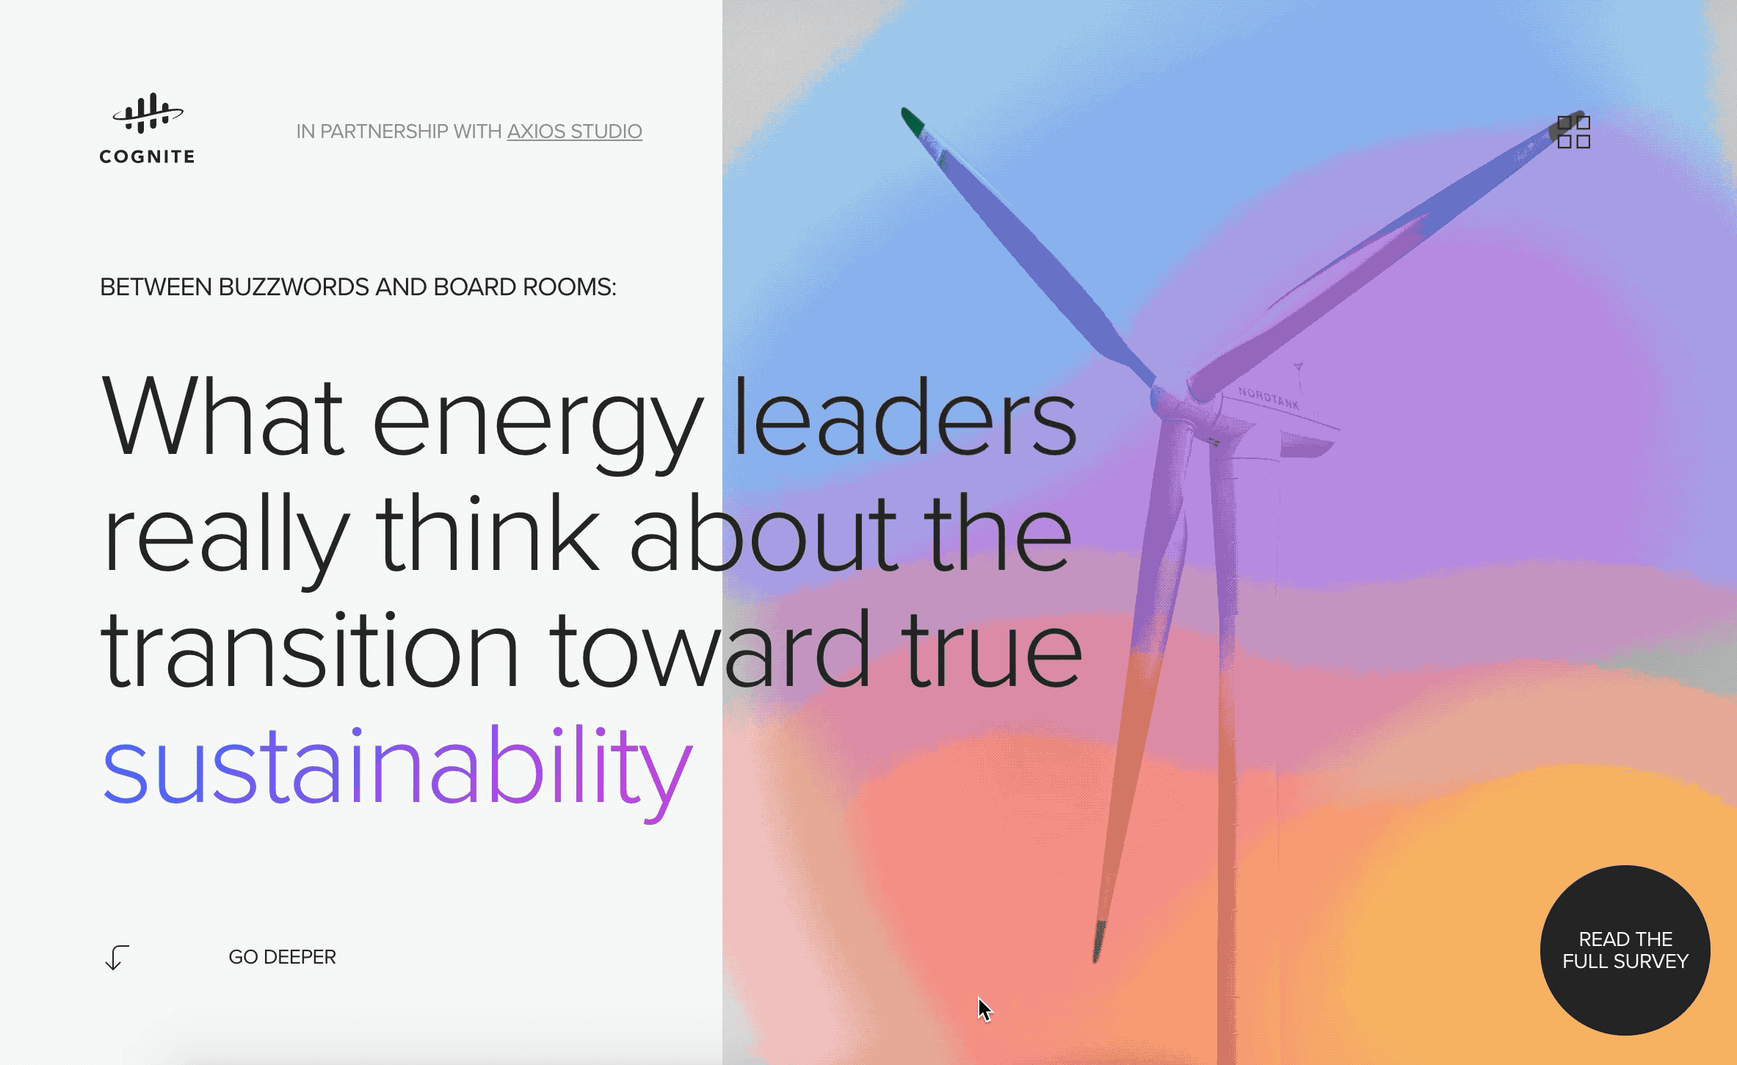
3. Topic Page
A custom landing page housed key report insights and promoted readers to download the full report to learn more.
Key takeaways
6,317
Page Views
5,851
Uniques
4:03
Average time on page
:46
Time on page (Industry average)

Slide 6
Appendix

Slide 7
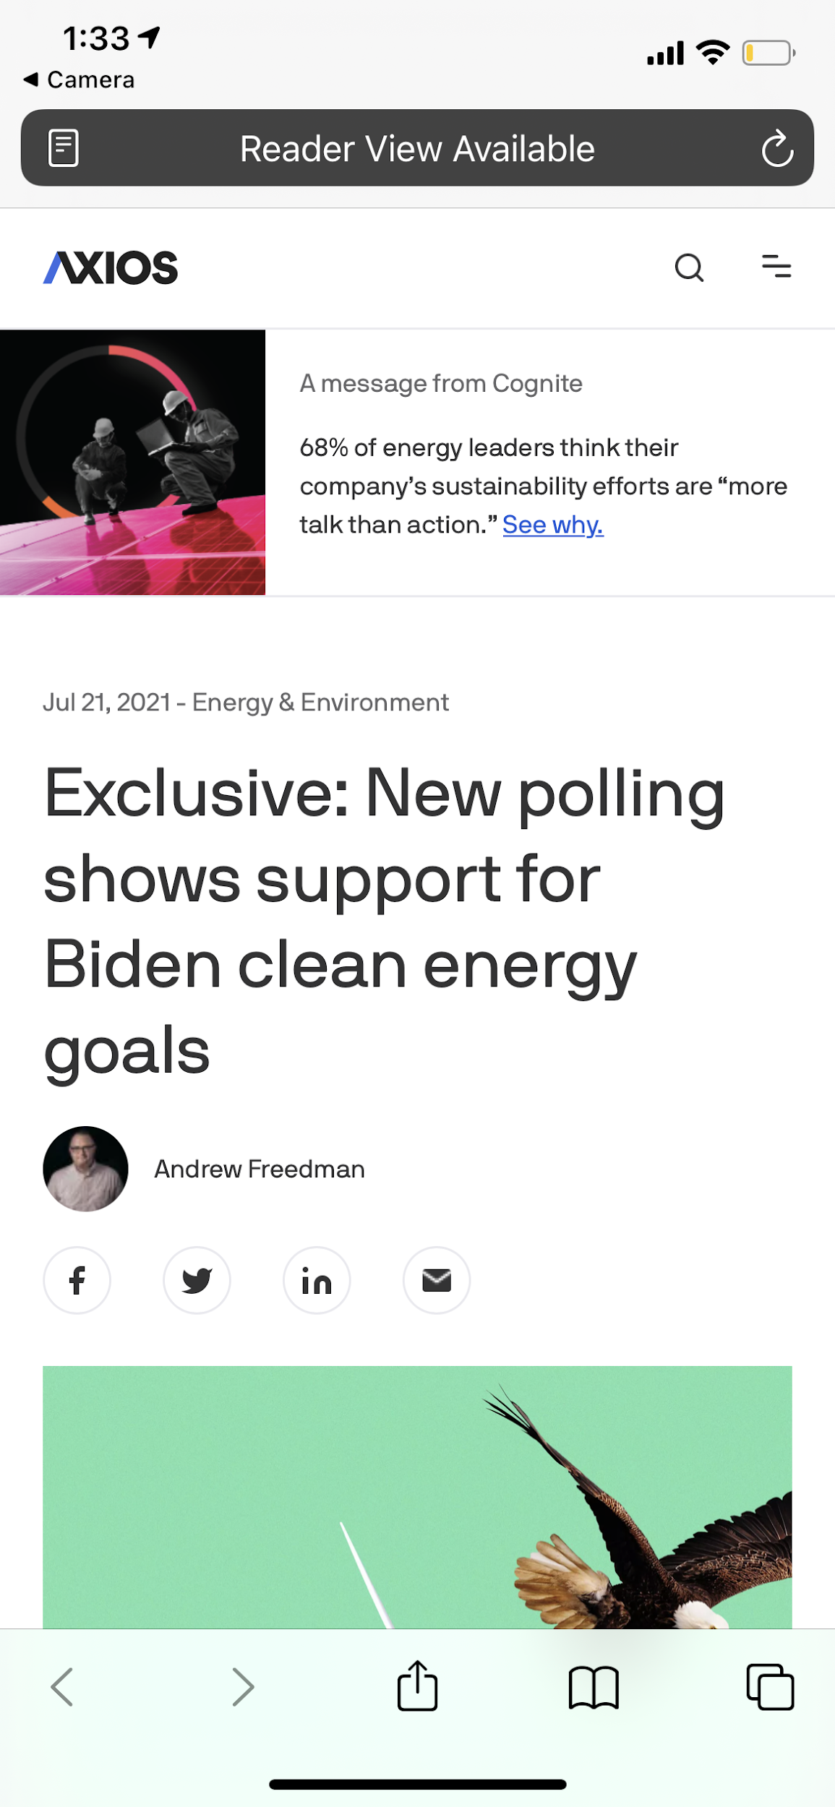
Campaign Screenshots
Apex 1 of 2
.14% CTR
Apex 2 of 2
.13% CTR

Slide 8
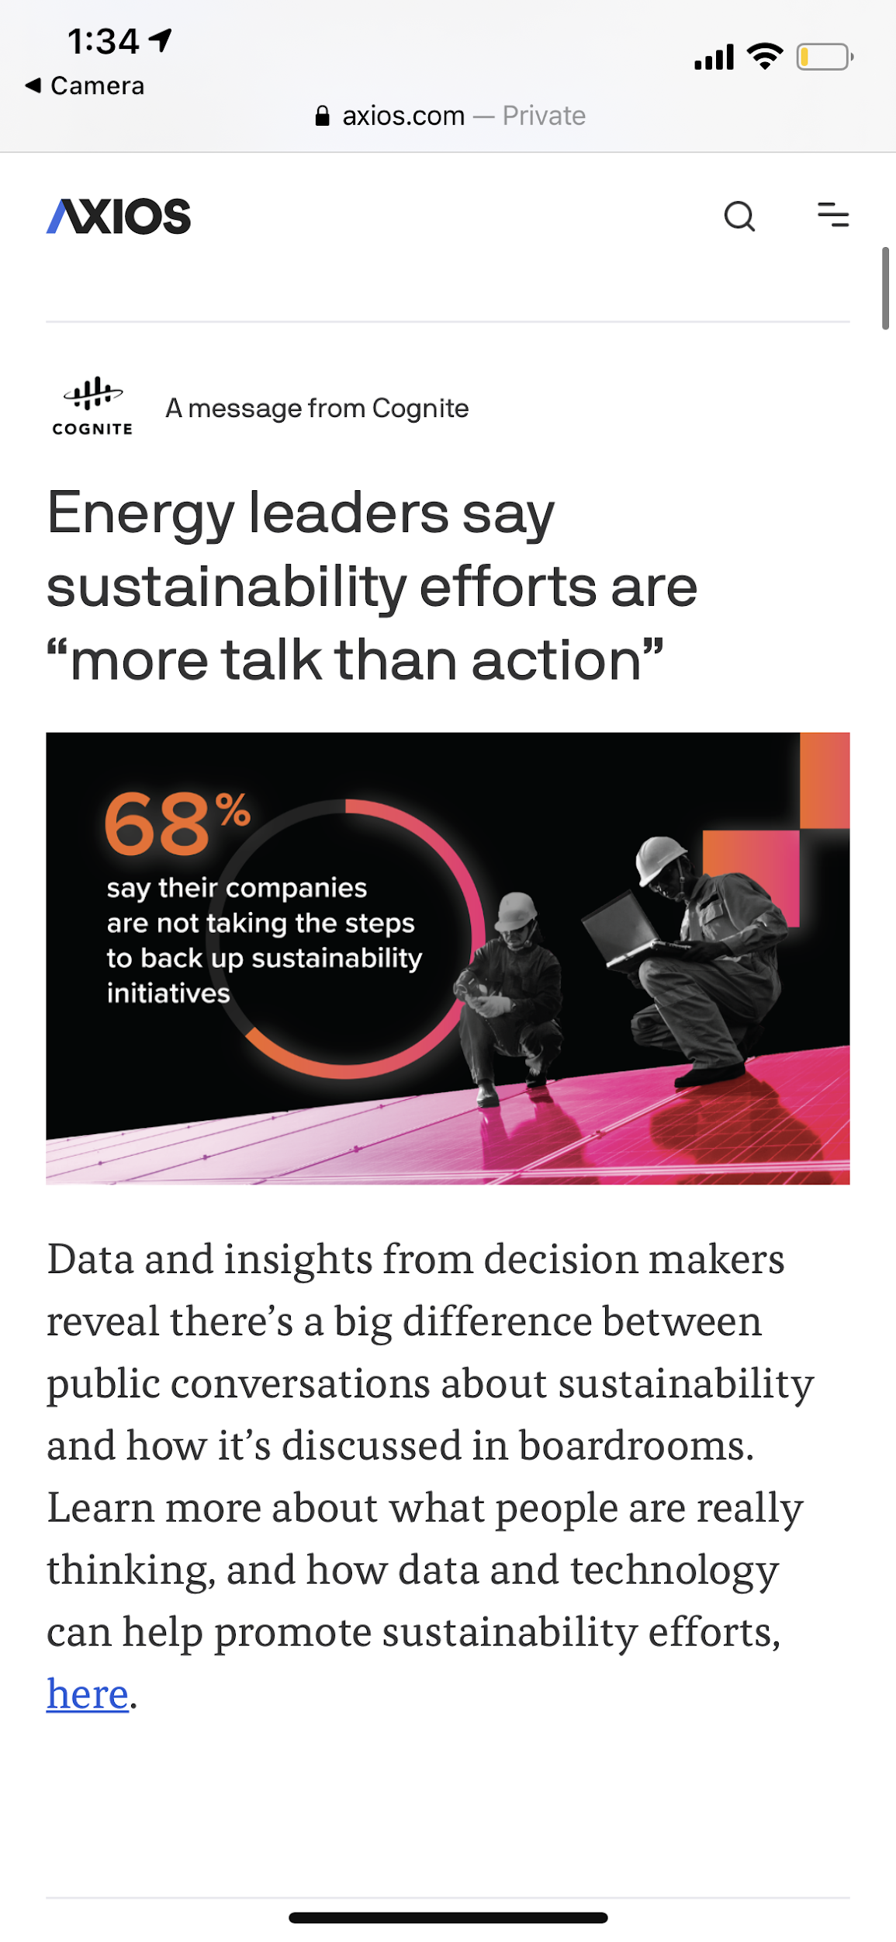
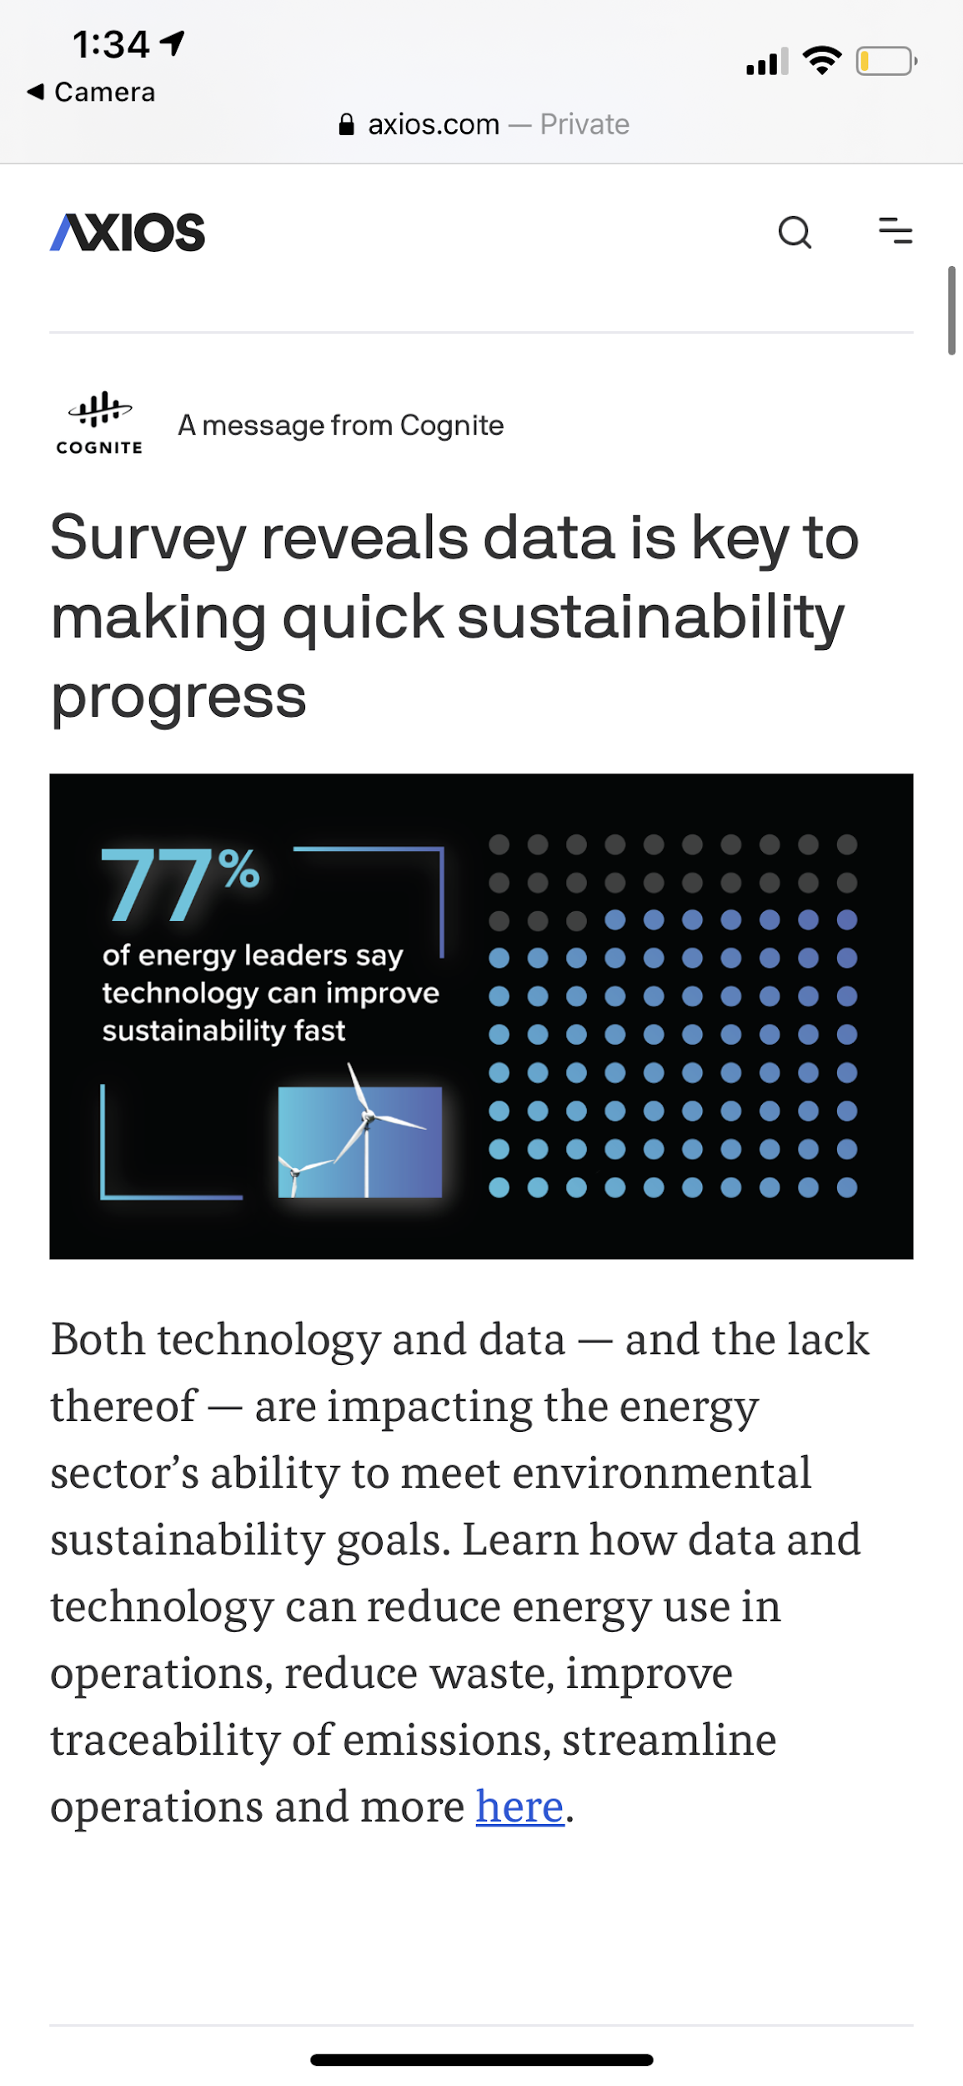
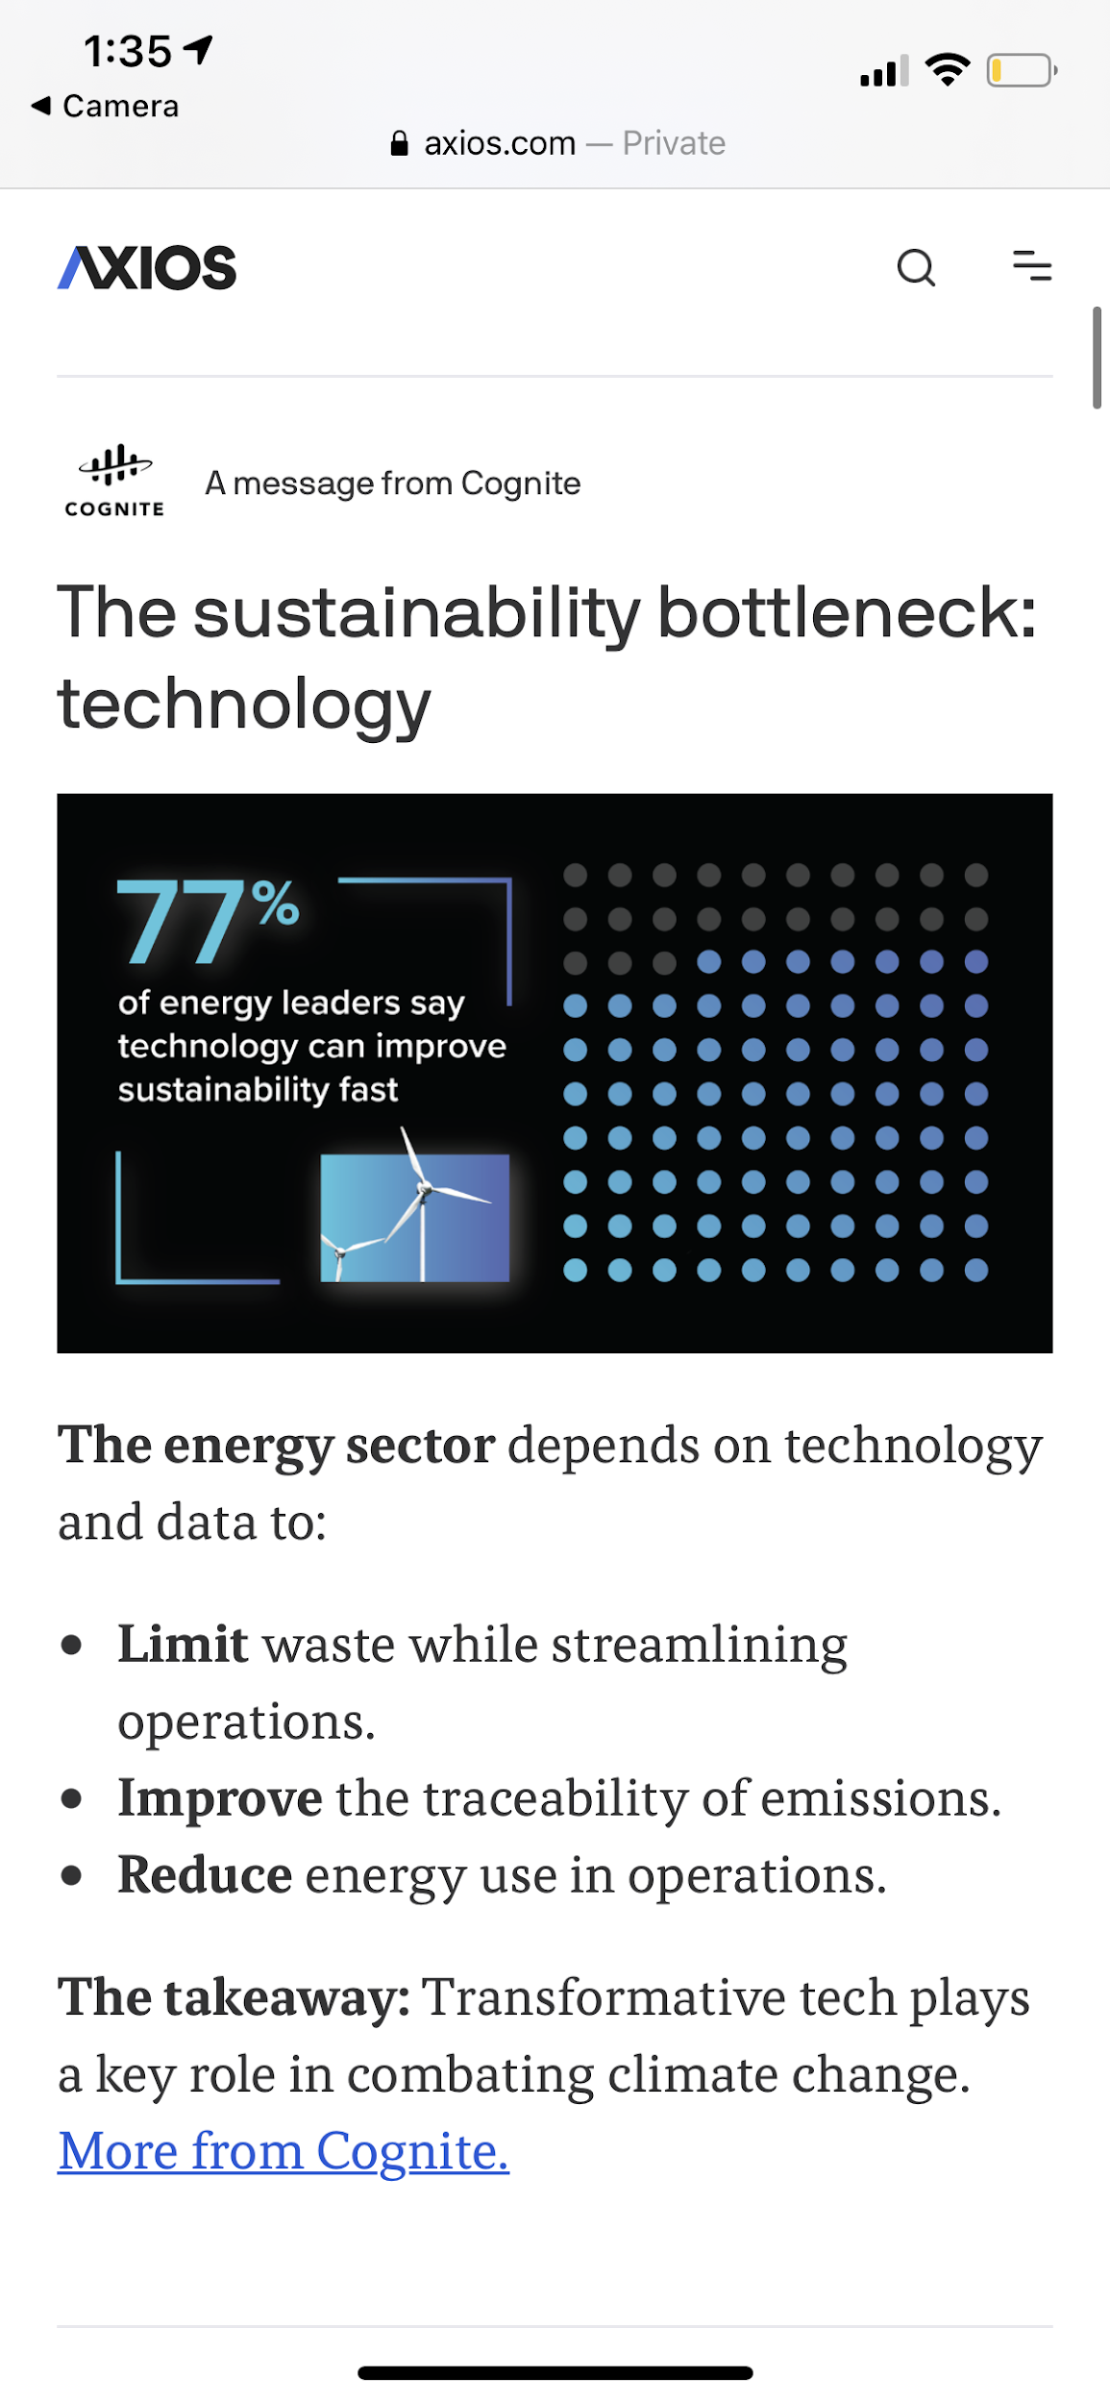
Campaign Screenshots
Smart Post 1 of 4
.11% CTR
Creative 2
.09% CTR
Smart Post 3 of 4
.11% CTR
Smart Post 4 of 4
.06% CTR

Slide 9
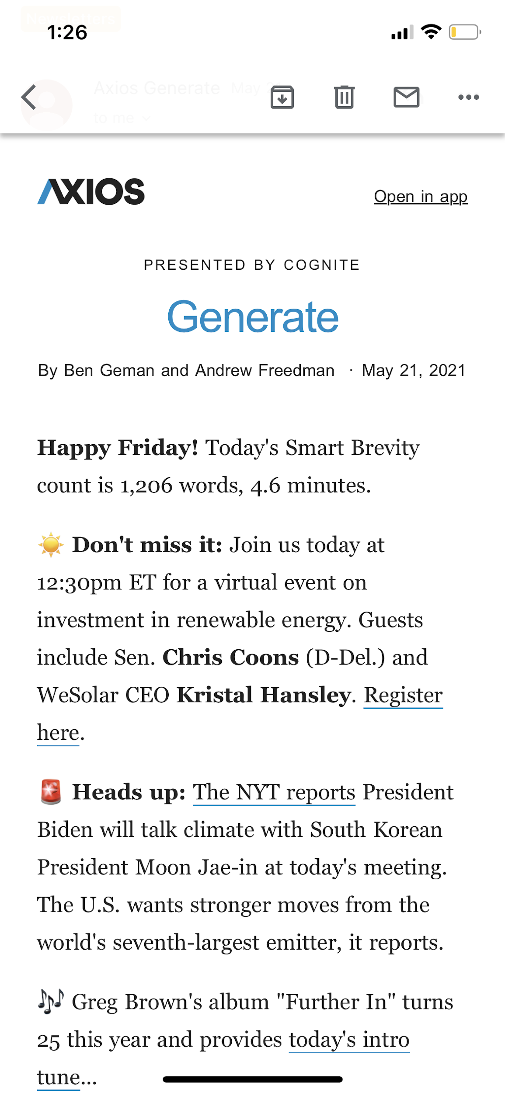
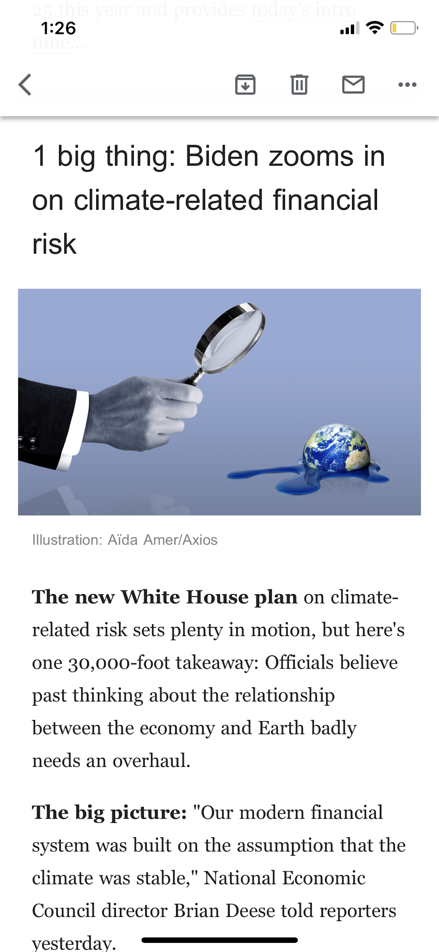
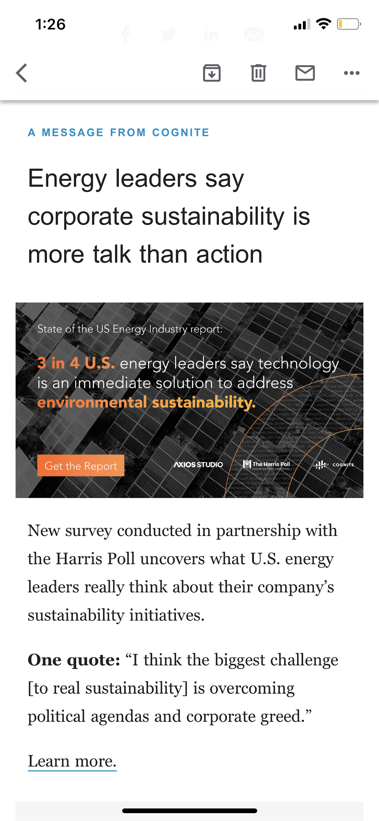
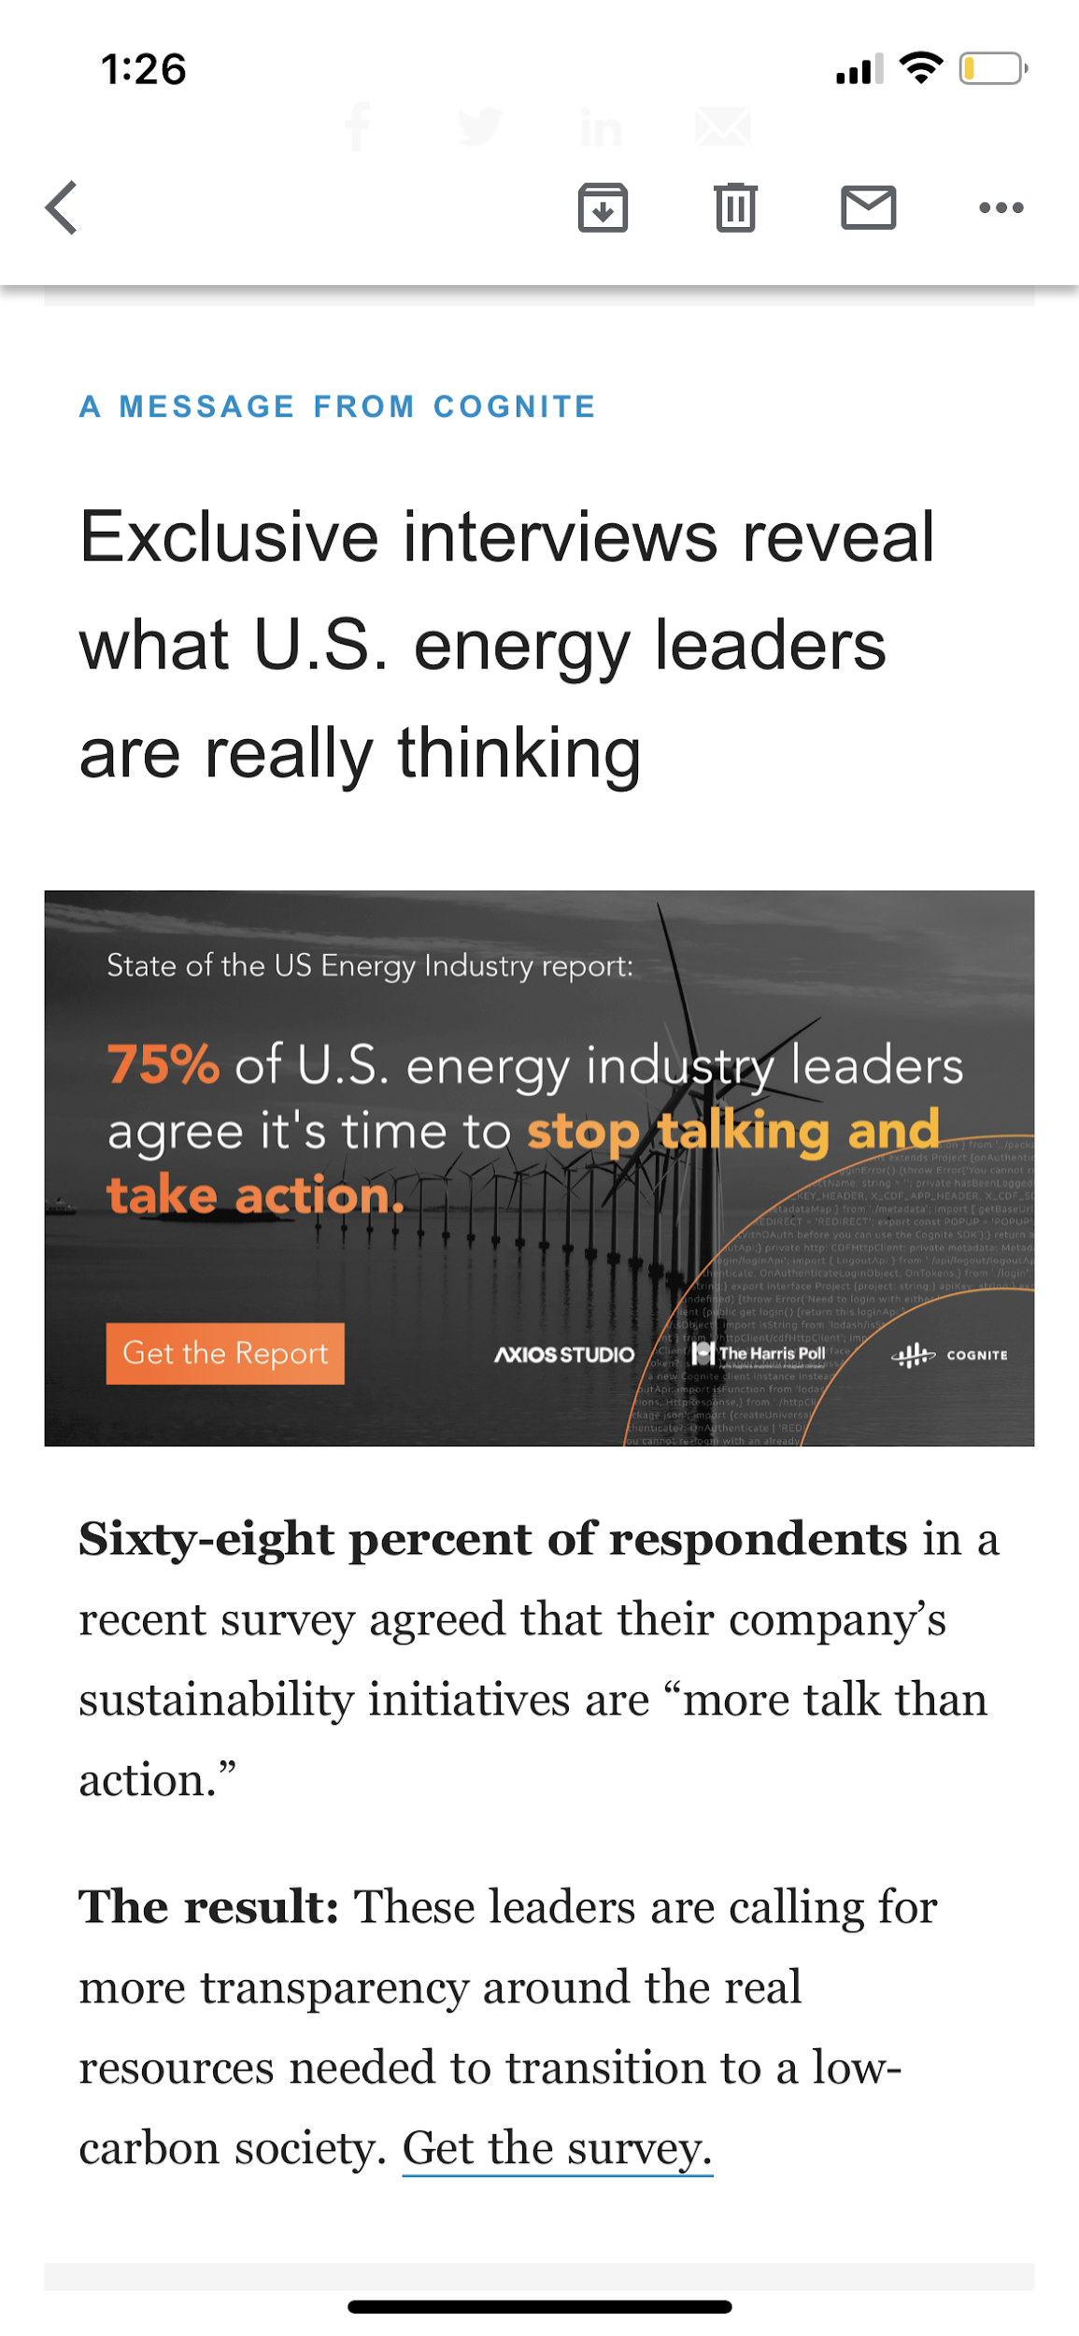
Promotion in Axios Generate Newsletter
Cognite mention at top newsletter
Alignment with Axios editorial content
Cognite Smart Post
(mid placement)
Cognite Smart Post
(end placement)

Slide 10
Thank you
Maggie Snipes
Client Partnerships
maggie.snipes@axios.com
Adrianna Glover
Client Success
adrianna.glover@axios.com

